Slide 1
TwinEngines Case Management
Workflow automation solution for the National Guard.
Customizable “Case Types” with pre-defined approval processes, tasking, and documentation requirements.
Top down and bottom up visibility with organization level security based on force structure.
Additional customizations possible (e.g. Directorates, Sections, etc.)
Notes:
NOTE: This presentation includes animations and is best viewed by starting the slideshow.

Slide 2
TwinEngines Case Management
Customizable email notifications alert users when activities are assigned to them, or completed by others.
Integrates with PERMS to automatically send documents attached to cases without having to print/scan/index.
High level statistics reports with drill down capabilities.

Slide 3
TwinEngines Case Management
Part of Etrans Manager, just requires a license key to unlock.
Runs on existing hardware
$2,500/year for 25 case types (i.e. Workflows/Business Processes).
Integrated with all TwinEngines products
Awards – case types for tracking time in service based awards and the DA638.
Discharges – case types for tracking the NGB22 and others related to Discharges/Separations.
Etrans Manager – case types for tracking electronic transactions (Gains, MILPO Orders)

Slide 4
TwinEngines Case Management
Example Solutions:
SAAR Processing
Track and manage all DA2875 forms, along with AUPs, Annual Training (DA87), and any additional forms (i.e. PII)
Simple Tasking Wizard
Guides you through quickly creating a Case Type with a single task for a list of Soldiers. Take any report with a list of Soldiers and quickly task multiple people/organizations for each of the Soldiers on the list.
Soldier Out-Processing
Creates 60+ tasks for multiple organizations to ensure Soldiers are out-processed properly.

Slide 5
TwinEngines Case Management
Example Solutions
STIG Application
Import STIG XML file to generate a case with a task for each STIG. Combine multiple STIGS into a single case type.
Data Quality Issues
Monitor personnel systems with a query to automatically generate cases on Soldiers with complete instructions to remedy the issue. For systems without query capability, manually copy/paste a list of Soldiers to generate cases.

Slide 6
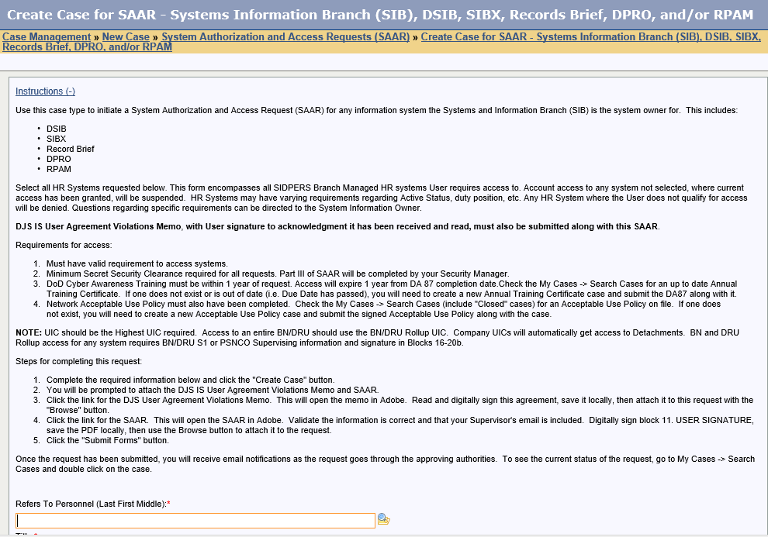
TwinEngines Case Management SAAR Processing
URL to create a new SAAR is accessible to any user with a network account
Includes customizable End User Instructions

Slide 7
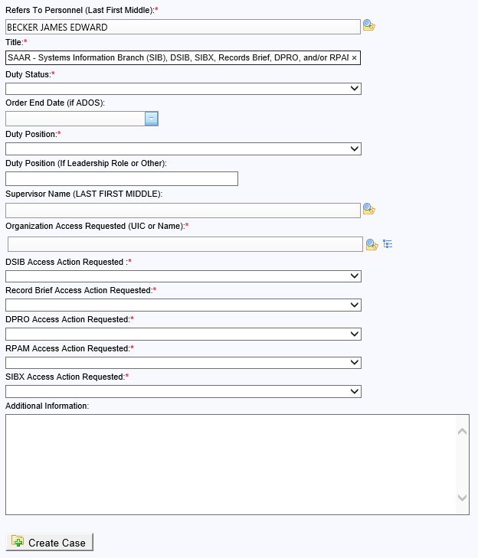
TwinEngines Case Management SAAR Processing
Defaults to end user’s information. If user is not recognized by system, they are asked to self-register before starting a new SAAR request.
Lookup for the Supervisor so that we know who to route the SAAR to.
The remaining fields are customizable and can be added to the SAAR as text in either block 13 (Justification for Access) or Block 27 (Optional / Additional Information)

Slide 8
TwinEngines Case Management SAAR Processing
End user is prompted to submit the required documents with digital signatures. Click the links to open the required form.

Slide 9
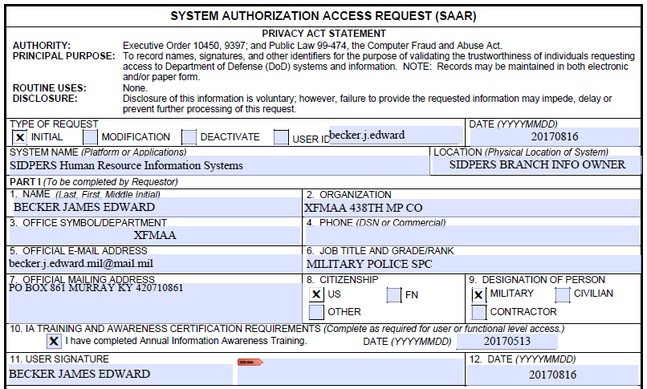
TwinEngines Case Management SAAR Processing
Prepopulated data
IA Training is tracked within the system as another case

Slide 10
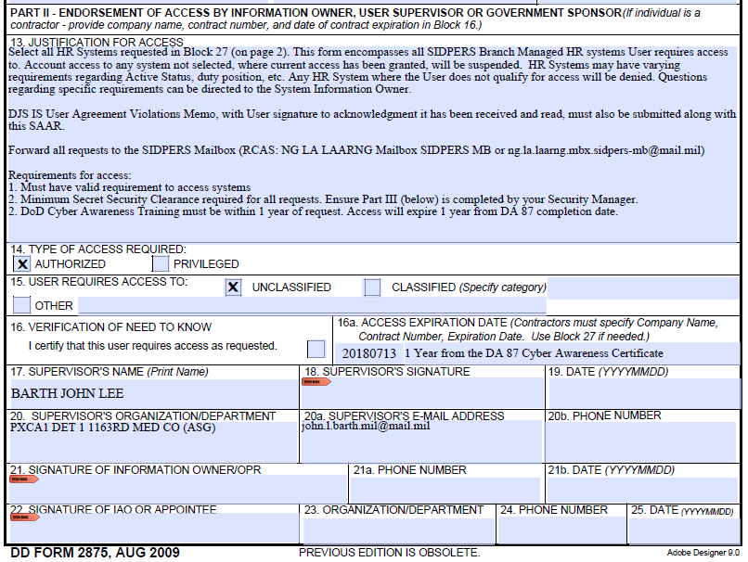
TwinEngines Case Management SAAR Processing
Prepopulated data

Slide 11
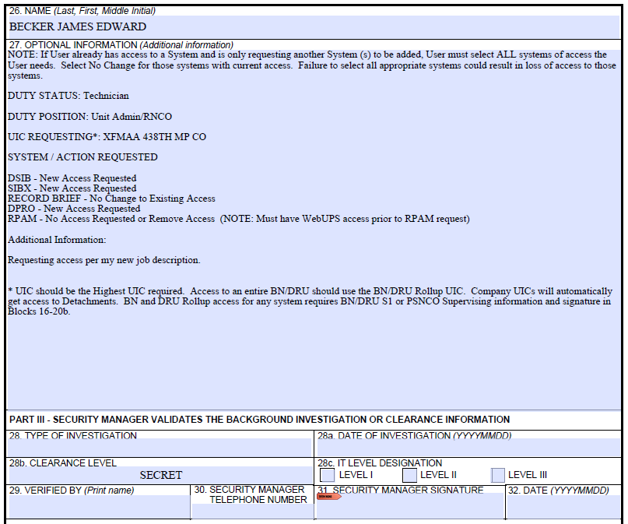
TwinEngines Case Management SAAR Processing
Custom input from user converted to text
Prepopulated data

Slide 12
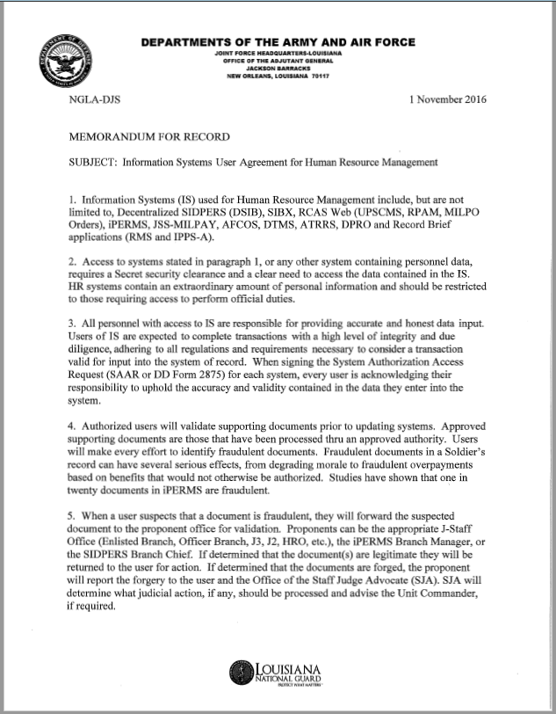
TwinEngines Case Management SAAR Processing
DJS User Agreement is an additional User Agreement required by the state SIB in order to access Personnel systems. Users must read and sign the agreement.

Slide 13
TwinEngines Case Management SAAR Processing
After documents are signed and attached, the case is submitted and the approval process begins.

Slide 14
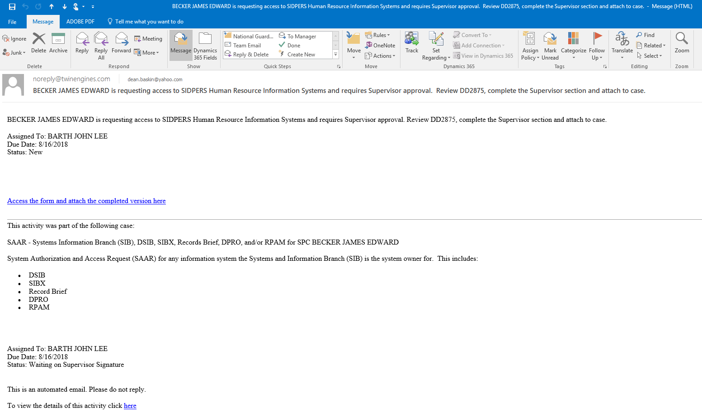
TwinEngines Case Management SAAR Processing
Email notification goes to the Supervisor.
Link to get the form from the website

Slide 15
TwinEngines Case Management SAAR Processing
Download the form from here, digitally sign the Supervisor’s section and save it.
Use the Browse button to locate the saved file.
Submit the SAAR to continue processing.

Slide 16
TwinEngines Case Management SAAR Processing
Can also access tasks assigned to you through the My Open Activities on the website.

Slide 17
TwinEngines Case Management SAAR Processing
SAAR continues approval process thru:
Security Manager
Information Owner
IAO (Optional)
Processor (Optional)
Each approver receives an email notification
Approver signs their portion and attaches the SAAR back to the case to continue processing.

Slide 18
TwinEngines Case Management SAAR Processing
After all signatures have been collected, tasks are created and assigned to the System Administrator for each system to grant requested access.

Slide 19
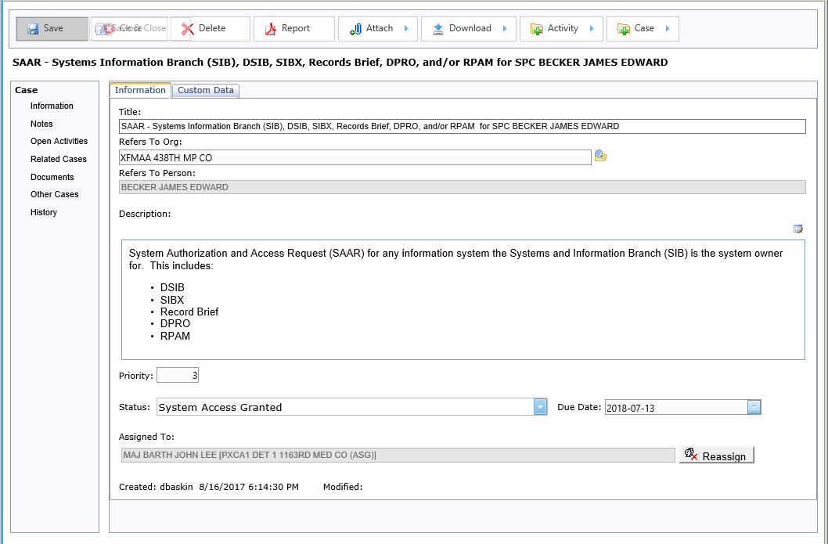
TwinEngines Case Management SAAR Processing
30 days prior to the Due Date (i.e. Access Expiration date) email is sent with notification about SAAR expiring.
If SAAR expires before a new SAAR has been completed and case has not been closed, notifications will be sent to System Administrators to revoke system access.
Once access is granted, case status is set to “System Access Granted”
Due Date for the case is set to the Access Expiration date from the SAAR

Slide 20
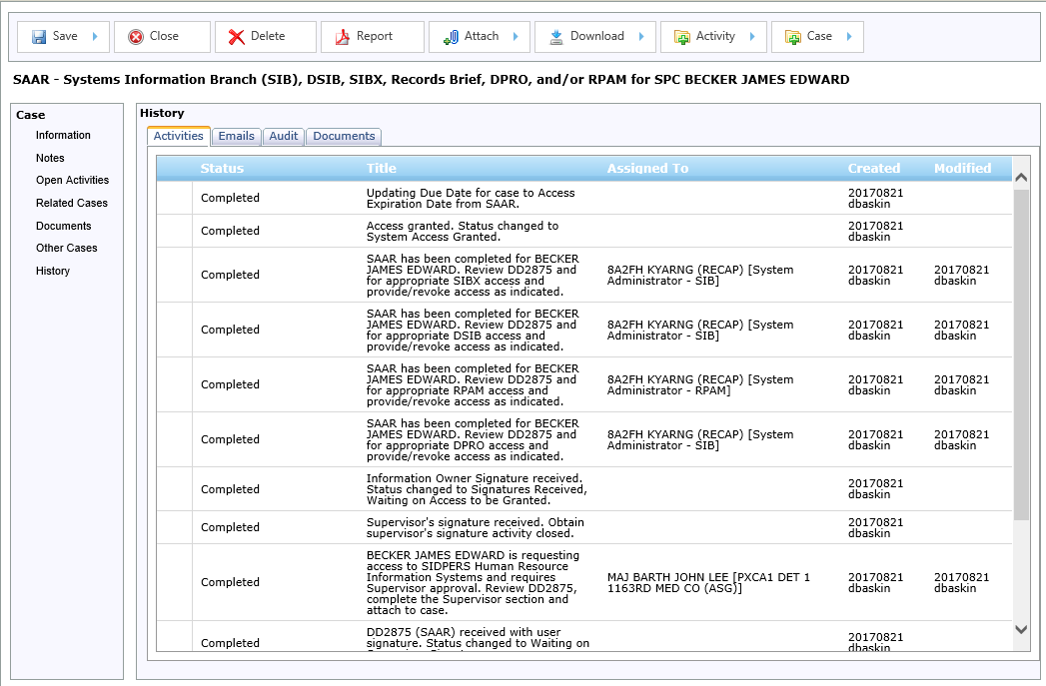
TwinEngines Case Management SAAR Processing
Case includes full history of:
Every step of the process
All email notifications sent
Any changes to the SAAR form (e.g. Signatures).
Each version of the SAAR that is submitted.

Slide 21
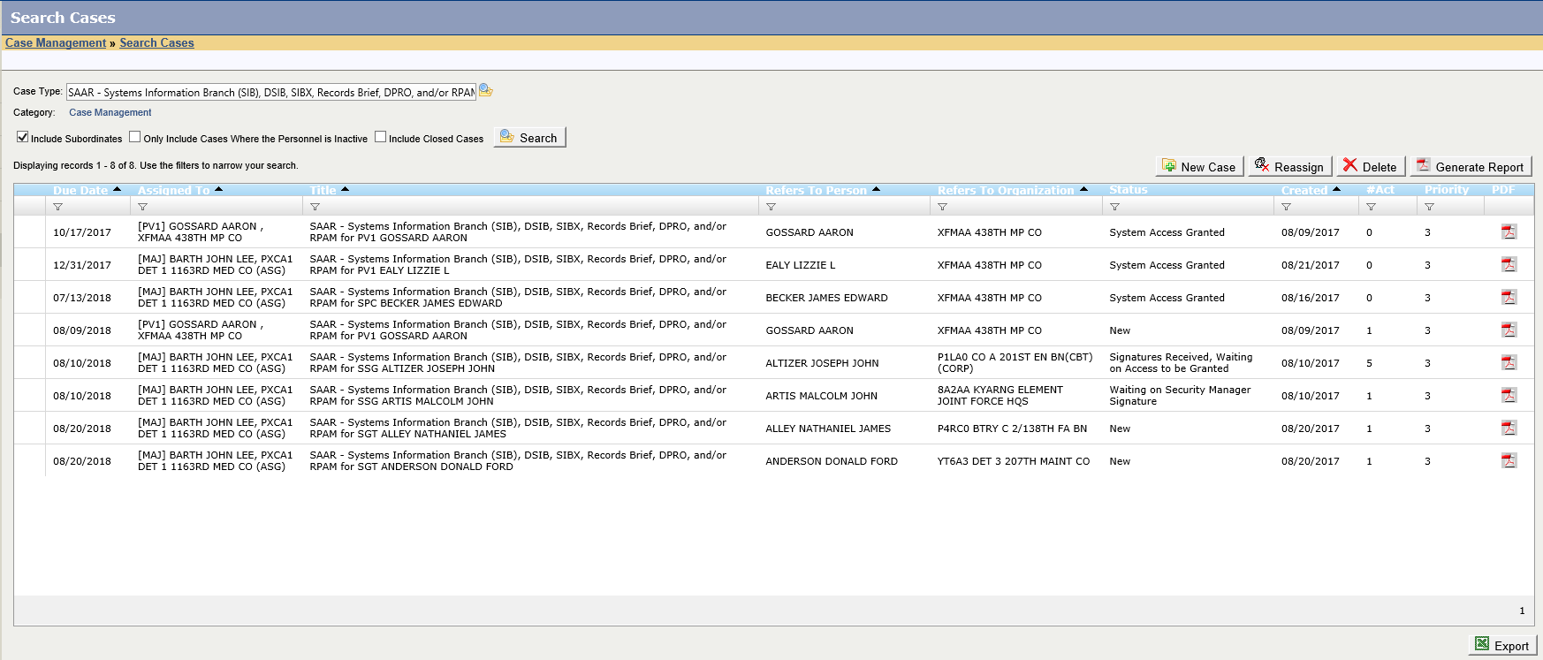
TwinEngines Case Management SAAR Processing
Search Cases shows all SAAR Cases and their Statuses.
End User that requested access can view the case in their “My Cases” screen and view all activities associated with it. They also get email notifications when activities have been completed.

Slide 22
TwinEngines Case Management Tasking Wizard
Use the Tasking Wizard here.

Slide 23
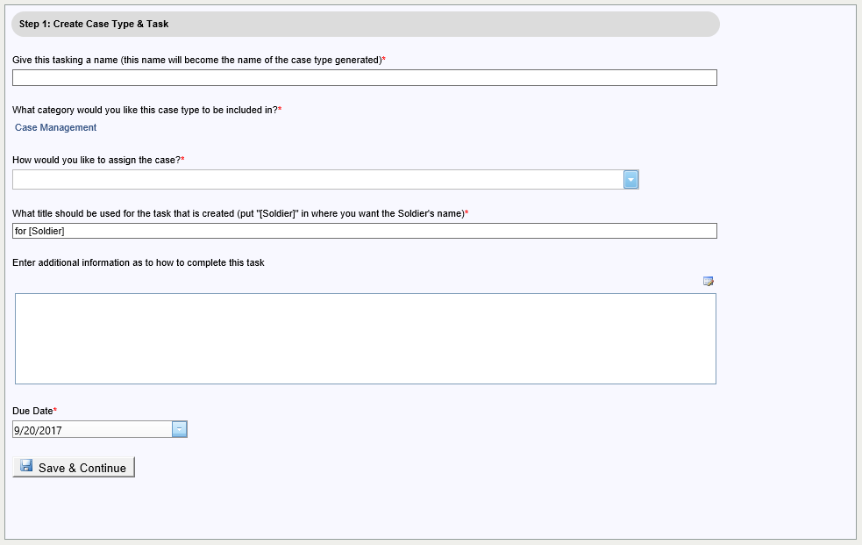
TwinEngines Case Management Tasking Wizard
Decide how to assign the task:
To a specific organization and a role (e.g. State Level).
To the Soldier’s organization and a role (e.g. Unit Level).
To the first org above the Soldier’s org that has a specific role (e.g. BN or BDE level).
Give the tasking a unique name
Assign it a category for reporting
Give the task a Title
Provide a more detailed description
Set a Due Date

Slide 24
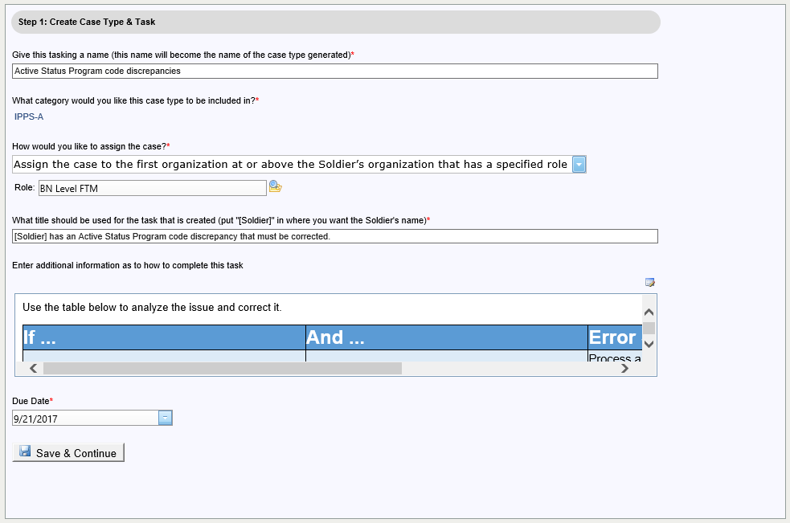
TwinEngines Case Management Tasking Wizard
Here we are assigning at the BN Level
These instructions were simply copied and pasted from the DQI Error Solutions spreadsheet put out by the MSTAC

Slide 25
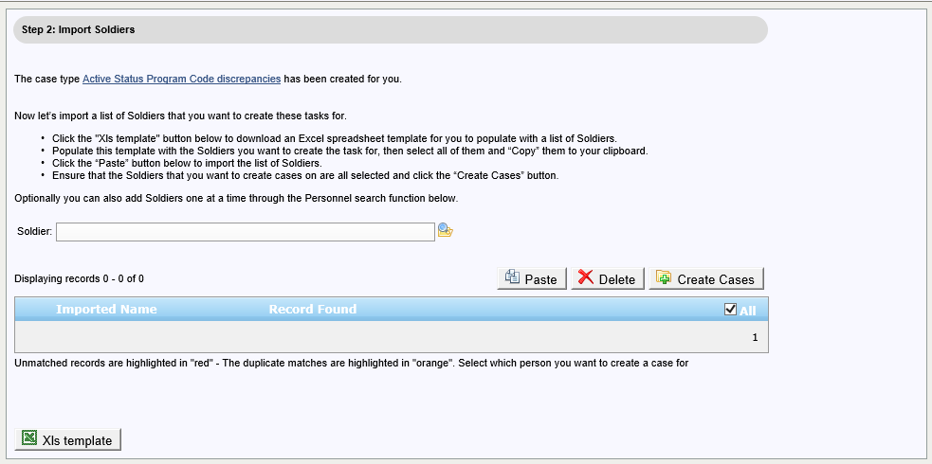
TwinEngines Case Management Tasking Wizard
You can copy a list of Soldier names from a spreadsheet (i.e. copy to clipboard with CTL+C), then import that list by clicking the “Paste” button here.
You can manually add individual Soldiers to the list by performing a lookup here.

Slide 26
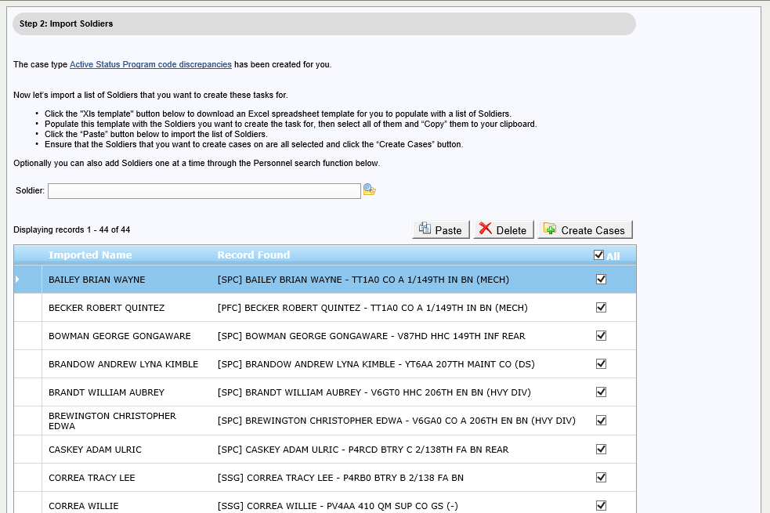
TwinEngines Case Management Tasking Wizard
Once you have all the Soldiers you want listed, click here.

Slide 27
TwinEngines Case Management Tasking Wizard
Cases are generated for all Soldiers in the list.
A “Bulk Case” is created that can be used to track all the cases together.

Slide 28
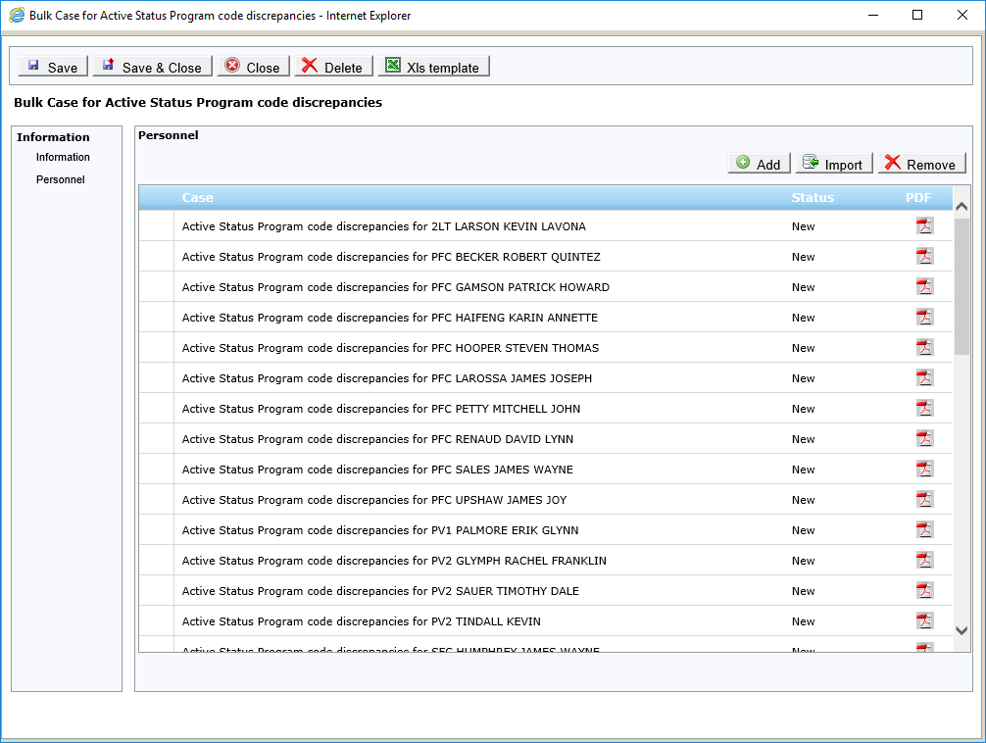
TwinEngines Case Management Tasking Wizard
Each case and it’s status is shown here.
Double clicking on the case will bring up the case detail.

Slide 29
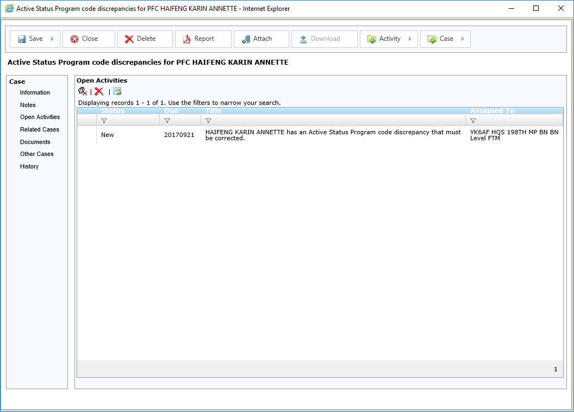
TwinEngines Case Management Tasking Wizard
Each case has a single task that was specified earlier in the wizard.
Notice the assignment at the BN level to the “BN Level FTM” role.
Double clicking on the task will bring up the details.

Slide 30
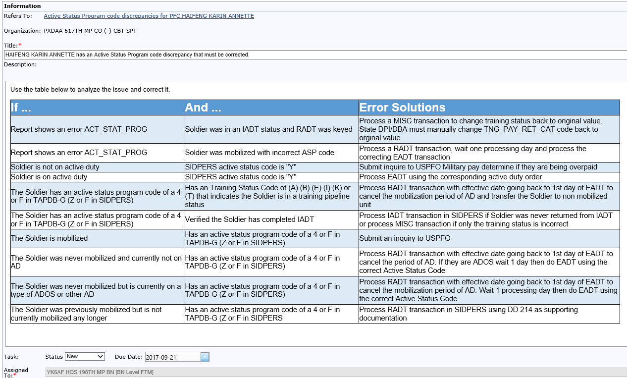
TwinEngines Case Management Tasking Wizard
Includes detailed description of the corrective action that needs to occur.
When completed, change the Status to “Completed” and this will close the case.

Slide 31
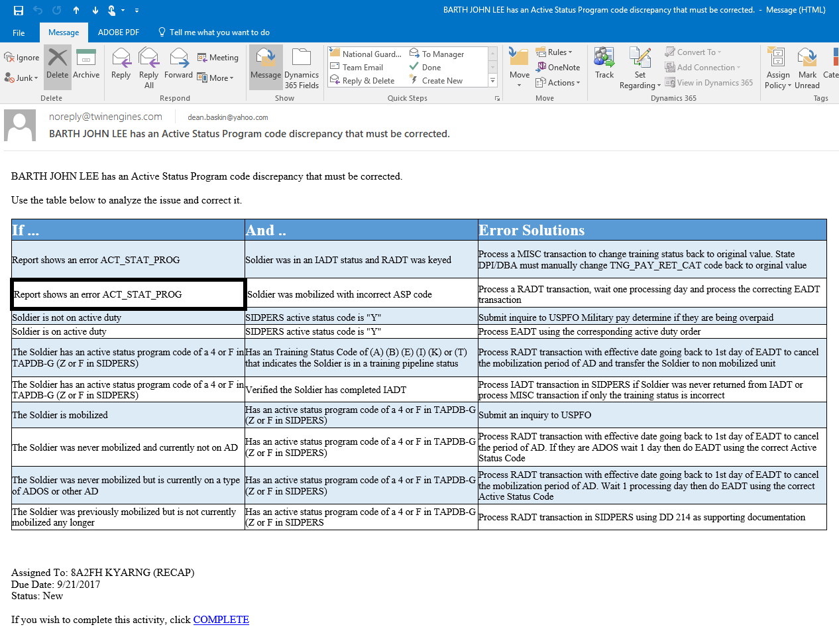
TwinEngines Case Management Tasking Wizard
No need to get into Case Management to find the task though – an email notification is sent with all the details when the case is created.
When completed, you can click here to close the case.

Slide 32
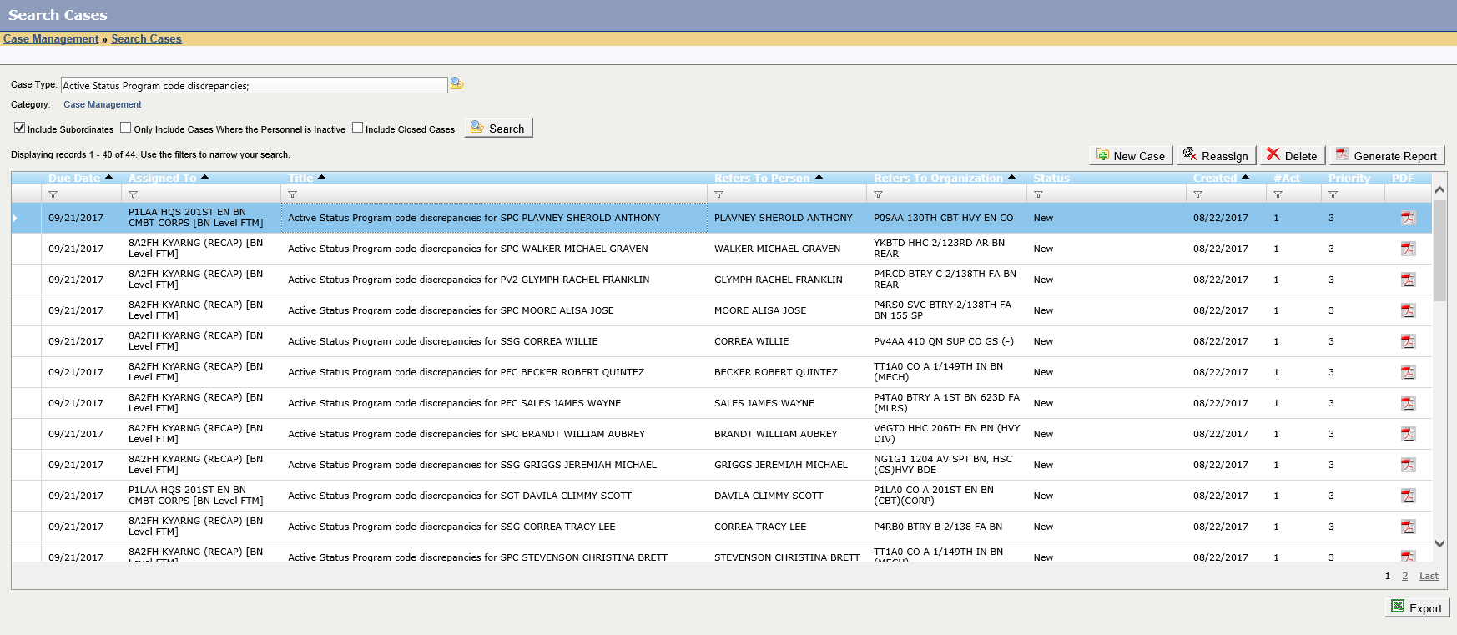
TwinEngines Case Management Tasking Wizard
Cases can be quickly located through Search Cases

Slide 33
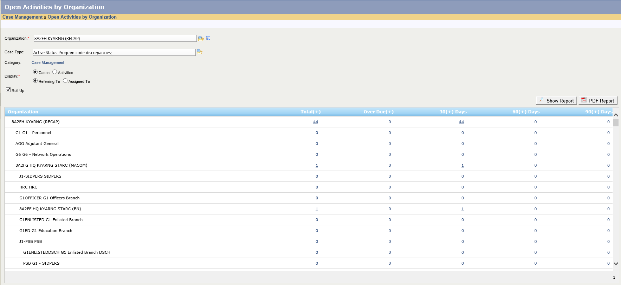
TwinEngines Case Management Tasking Wizard
Drill down reports show the status by Organization

Slide 34
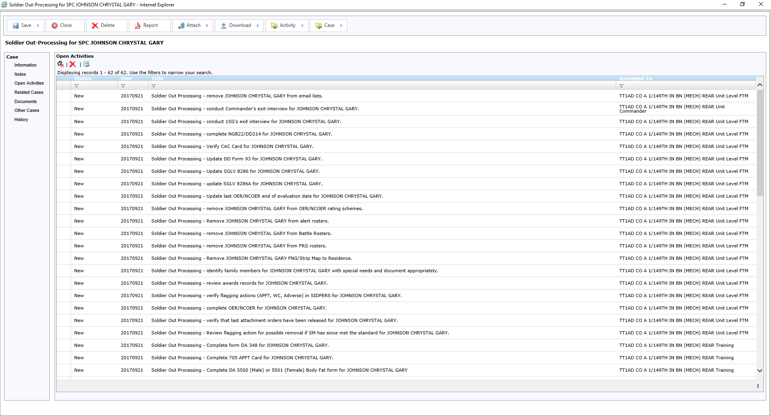
TwinEngines Case Management Soldier Out-Processing
Automatically generate a Soldier Out-Processing case whenever a Discharge or Separation Order is published in MILPO Orders.
This example includes 60+ tasks to be completed that are assigned to 7 different people, including Unit Level FTM, Commander, Training, Finance, Medical, Supply, and Facilities

Slide 35
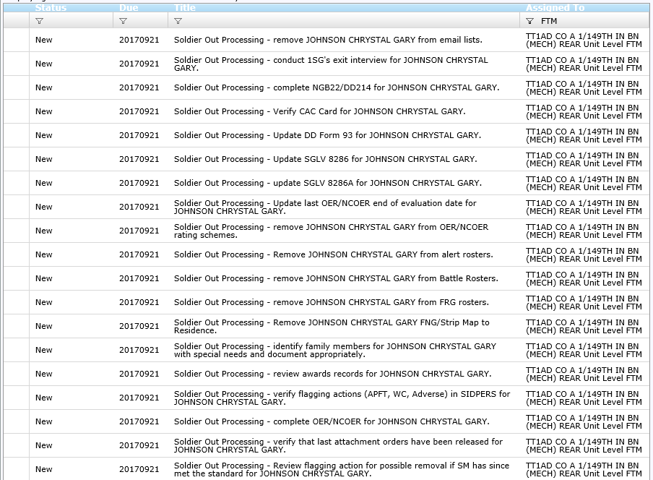
TwinEngines Case Management Soldier Out-Processing
19 tasks assigned to the Unit Level FTM at the Soldier’s organization

Slide 36
TwinEngines Case Management Soldier Out-Processing
7 tasks assigned to Training

Slide 37
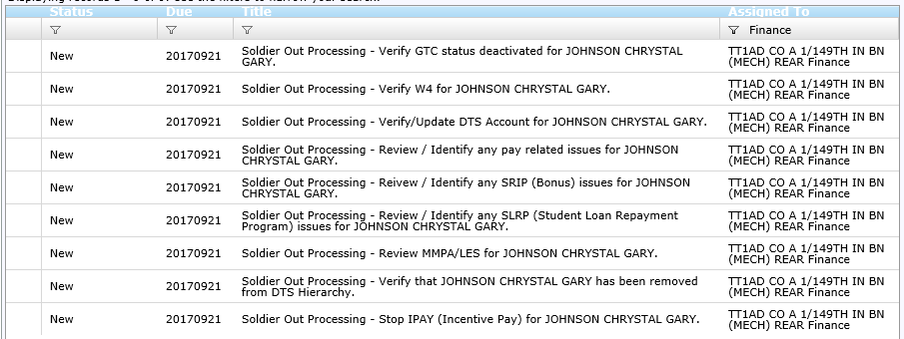
TwinEngines Case Management Soldier Out-Processing
9 tasks assigned to Finance

Slide 38
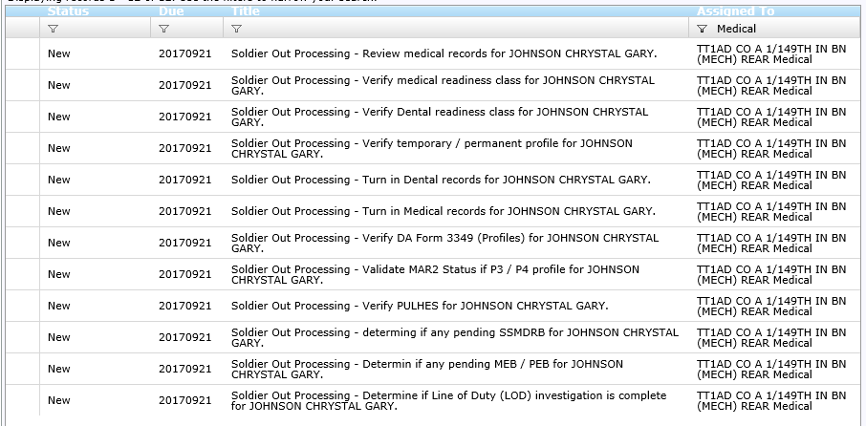
TwinEngines Case Management Soldier Out-Processing
12 tasks assigned to Medical

Slide 39
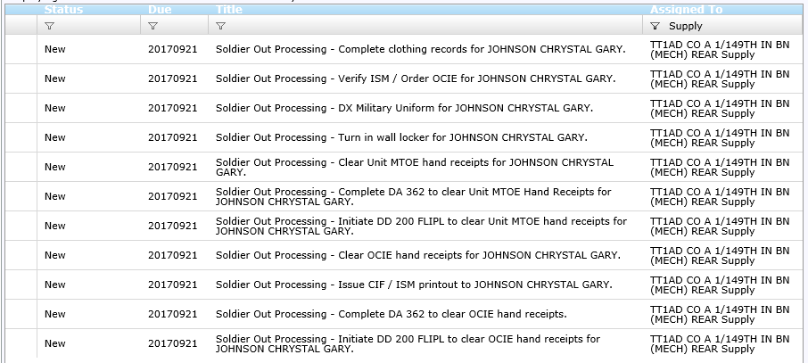
TwinEngines Case Management Soldier Out-Processing
11 tasks assigned to Supply

Slide 40
TwinEngines Case Management Soldier Out-Processing
3 tasks assigned to Facilities

Slide 41
TwinEngines Case Management Soldier Out-Processing
1 task assigned to the Commander

Slide 42
TwinEngines Case Management
For questions, live demos, or to request an evaluation key, contact:
Dean Baskin
TwinEngines, Inc.
859-536-2540
dbaskin@twinengines.com

