Slide 1
TwinEngines Discharges
This presentation will help you make the transition to the new version of the TwinEngines Discharges application.
Please view in SlideShow mode and use mouse clicks or space bar to advance slides.

Slide 2
TwinEngines Discharges
Reasons for migration
New/improved look and feel
Out-dated technology causing problems with Windows 10 & IE in some states
Old system will have no future updates
Accreditation done on new version of System
Accreditation required some code changes like automatically expiring user accounts.
Old system accreditation has expired
New/Enhanced Functionality
Notes:
NOTE: This presentation includes animations and is best viewed by starting the slideshow.

Slide 3
TwinEngines Discharges
New Functionality
Built on top of Case Management technology that allows attaching documents and customizable tasking/workflow
Default workflow does everything at state HQ level
Can be customized to involve Units/BN/BDE approvals
Digital Signatures
Integration with PERMS Integrator
Sends NGB22 and Discharge Certificate to PERMS without having to print/scan/index
Email notification of tasking
NGB22A support

Slide 4
TwinEngines Discharges
New Functionality (continued)
Track additional discharge Case Types
ETS
MRD
Forced Separation
AWOL, BCT, and other Unit initiated Discharges
Enhanced reporting
Drill down by organization
Statistics (New, In Progress, Completed) by Month & Week

Slide 5
TwinEngines Discharges Installation
Request key from dbaskin@twinengines.com
Download latest version of TwinEnginesWebSetup from http://nationalguard.twinengines.com
Support -> Downloads
Run the TwinEnginesWebSetup on the web server
Installation will prompt for SQL login/password for the application to use and a SQL administrative login to create/update database
Also prompted for an application Administrator account that will have rights to assign users in the system
Installation does NOT affect old version of Discharges and can be run concurrently

Slide 6
TwinEngines Discharges Accessing the Site
After installation, a new website is created called “TwinEngines”.
Old URL: https://servername/cmswebservices
New URL: https://servername/twinengines
If you get a “Confirm your Identity” web page, you do not have roles to access the website.
Confirm your identity by putting in your SSN and finding your SIDPERS record, plus entering your email address.
This creates a user account in the system for you, then a TwinEngines Admin user (created during install) can give you the Discharges roles.

Slide 7
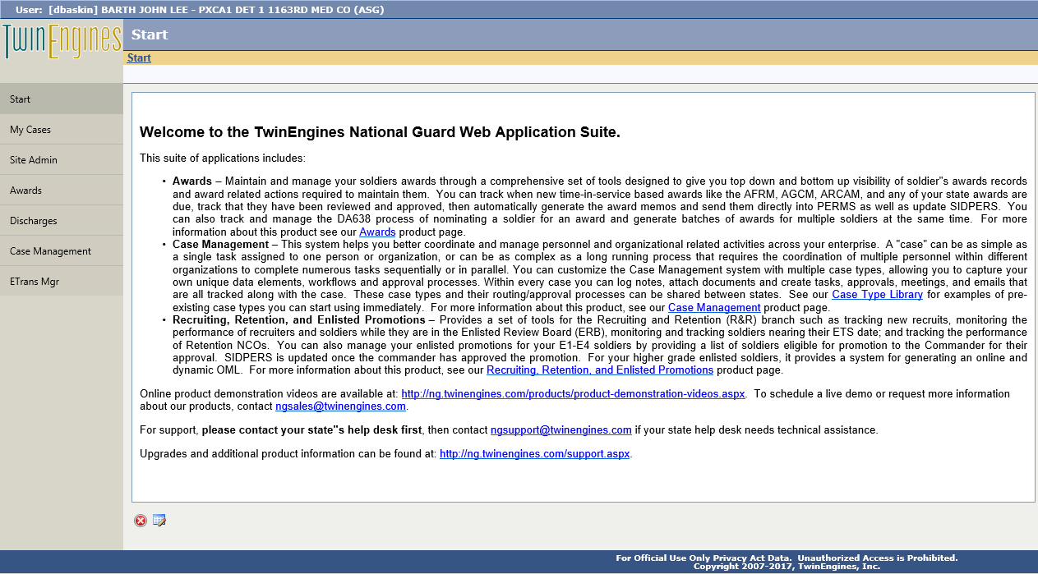
TwinEngines Discharges New Website
New website looks like this
Click the Discharges tab
This page and the icon in the upper left corner are customizable by clicking here

Slide 8
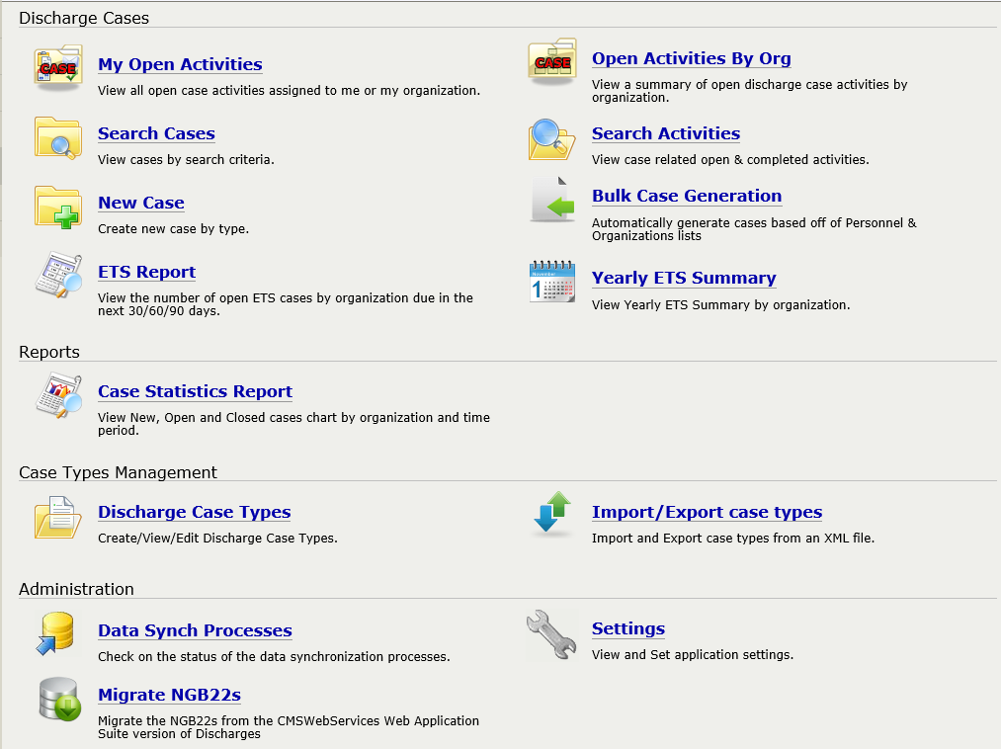
TwinEngines Discharges Main Page
NGB22s are created as “Cases” in the system and can be found here
Settings need to be configured for the new system

Slide 9
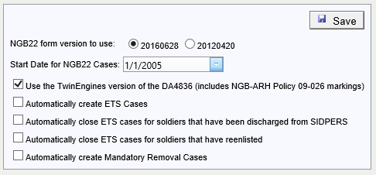
TwinEngines Discharges Settings
Support for 2 versions of the NGB22 form:
20160628 – latest version
20120420 - same version as in old system, no “Soldier not Available for Signature” option though
Set this date to the day you want to cut over to the new system. The system will start creating NGB22 cases for all DSCH/SEP orders published in MILPO Orders after this date. Defaults to the date the new system was installed.
Options if you want to track ETS cases in the system.
Also track MRD Cases

Slide 10
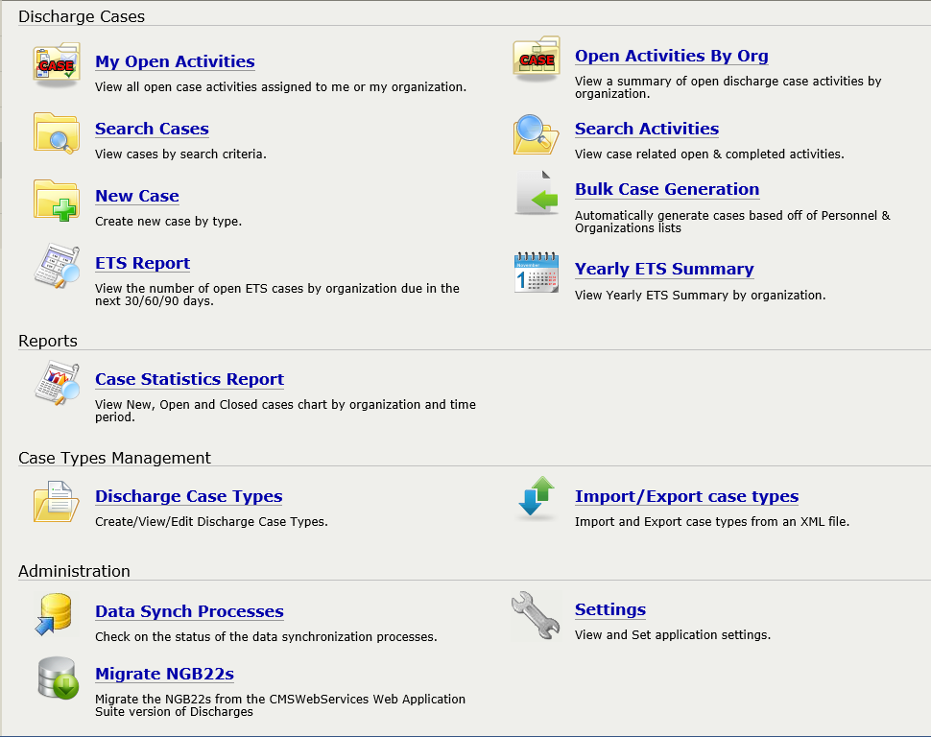
TwinEngines Discharges Migrating Data
Use the Migrate NGB22s option to bring your NGB22s over from the old Discharges system

Slide 11
TwinEngines Discharges Migrating Data
You can run the migration multiple times and wipe out the old data prior to importing it again.
Click here to start the migration process.

Slide 12
TwinEngines Discharges Migrating Data
You can see the migrated NGB22s here

Slide 13
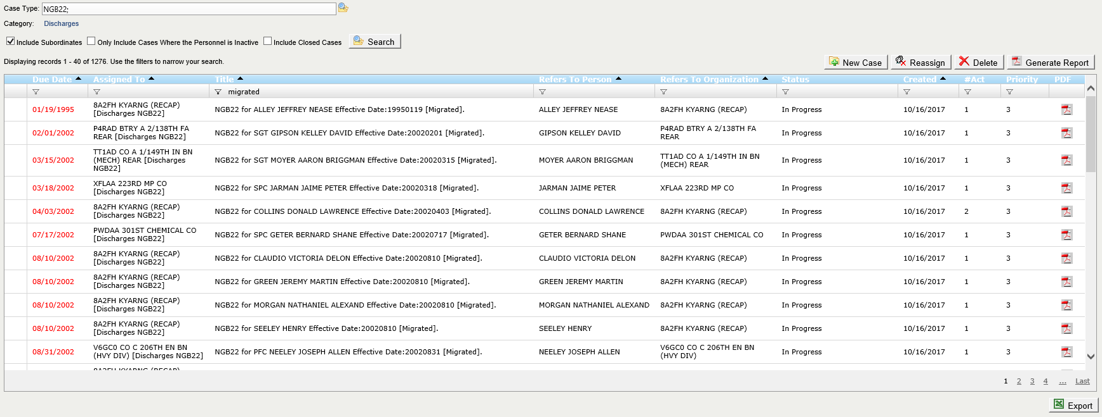
TwinEngines Discharges Migrating Data
NGB22s that have already been completed will be brought over in a “Completed” status. Check the “Include Closed Cases” to see these cases.
NGB22s that have been migrated will include “[Migrated]” in the title of the case. You can filter the records with the filter icon at the top of the grid.

Slide 14
TwinEngines Discharges Processing NGB22 Cases
Workflow/tasking is customizable
Default Case Type
Case assigned to Enlisted/Officer branch
Discharges NGB 22 user in either Enlisted or Officer branch assigned task to complete NGB22 form
RPAM user assigned task to close out RPAM statement
Discharges NGB22 Approval Authority at either Enlisted or Officer branch assigned to review/approve form
Discharges NGB22 Authorizing Officer at either Enlisted or Officer branch assigned task to digitally sign form.
NGB22 sent to PERMS via PERMS Integrator
Discharges NGB22 user assigned task to print/scan/attach Discharge Certificate to case.
Discharge Certificate sent to PERMS via PERMS Integrator
Task to mail documents assigned to Discharges NGB22 user.

Slide 15
TwinEngines Discharges Processing NGB22 Cases
Workflow/tasking is customizable
Other Options
Case assigned to unit, routed through BN for approval, signed by BDE, sent to PERMS without State HQ involvement
Case assigned to unit, routed through BN for approval, signed by BDE, approved by State HQ, then sent to PERMS
Case assigned at State HQ level without being broken out to Officer/Enlisted branches
Additional tasking added/removed from system (e.g. some states aren’t using the RPAM notification)
Contact TwinEngines for customization options

Slide 16
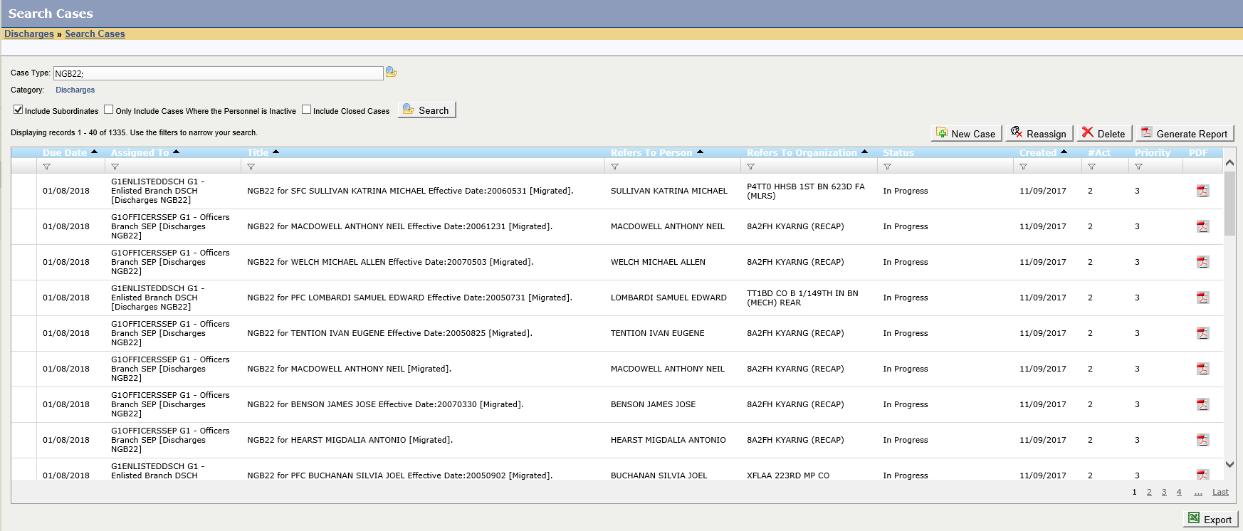
TwinEngines Discharges Processing NGB22 Cases
Open the case to work through the process of completing the NGB22. You bring up the case by double clicking.
The default NGB22 case gets assigned to either the Enlisted or Officer’s branch at the State HQ and the “Discharges NGB22” user
The actual Soldier for the NGB22 and their unit is here.

Slide 17
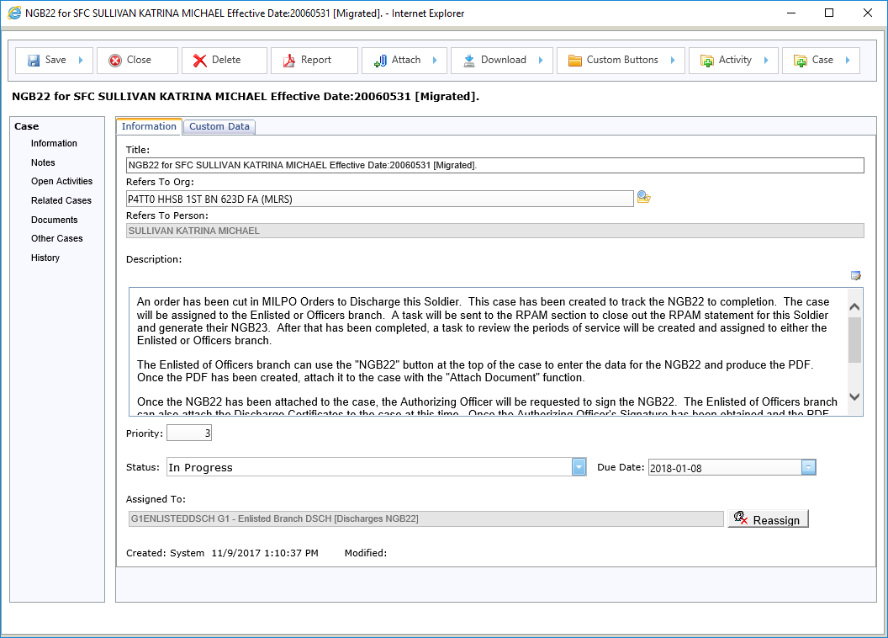
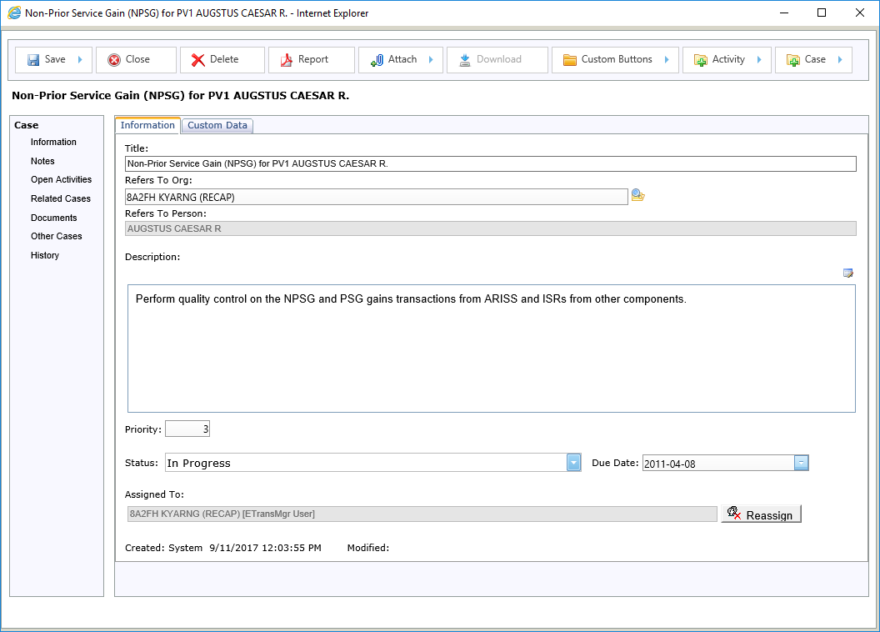
TwinEngines Discharges Processing NGB22 Cases
Create new cases for the same Soldier from here.
You can create ad-hoc activities (e.g. Tasks, Approvals, etc.) from here.
Download them from here.
Buttons can be customized for each type of case. Look here for functions that are unique to the type of case you are currently working on.
This is the case screen for the TwinEngines Case Management system. All cases within the TwinEngines systems (e.g. Awards, Discharges, Etrans) have the same capabilities.
Attach documents here.
View the current activities (e.g. Tasks, Approvals, etc.) here.
Add/View notes here.
Let’s look at the Activities for this case.
View and link other cases in the system to this case from here.
View all documents attached to the case from here
View all cases on the Soldier from here
View the audit history for this case from here

Slide 18
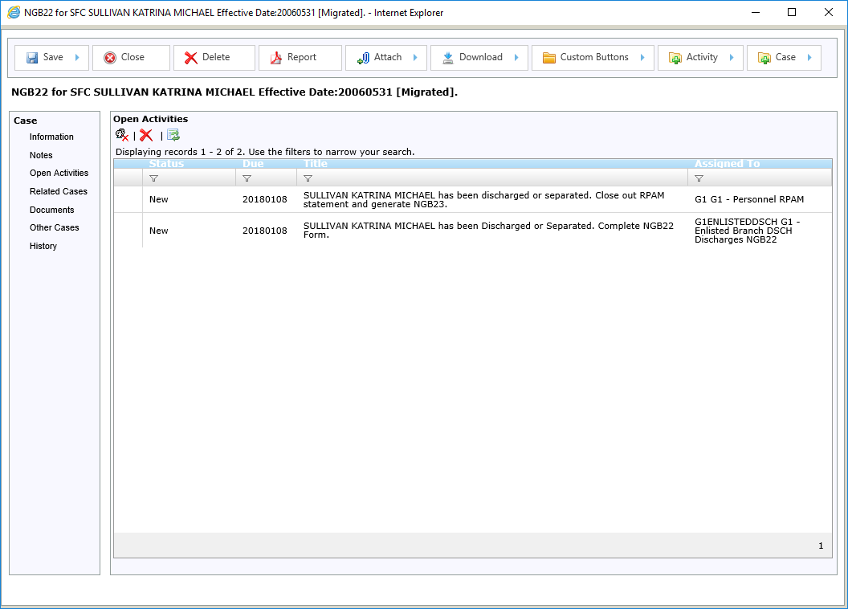
TwinEngines Discharges Processing NGB22 Cases
Although the case is assigned to one group, activities within the case can be assigned to any number of groups or individuals.
Each time an activity is created, any user with the assigned organization and role will be sent an email notification.
The task to close out the RPAM statement and prepare the NGB23 is assigned to a RPAM user.

Slide 19
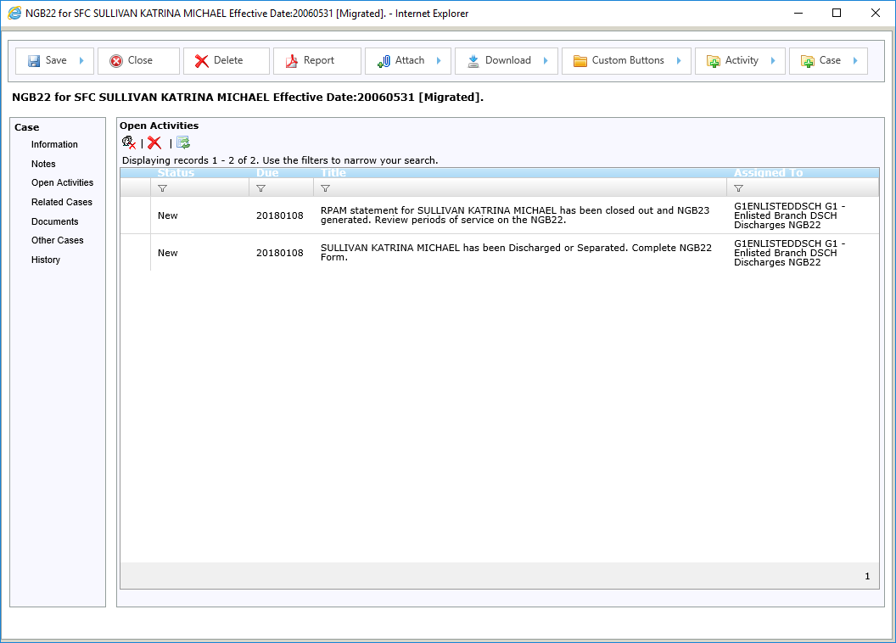
TwinEngines Discharges Processing NGB22 Cases
After the RPAM user completes their task, a new activity is assigned to the Discharges NGB22 user that is working on the 22. This alerts them that RPAM is now up to date and that they should review the periods of service on the NGB22.

Slide 20
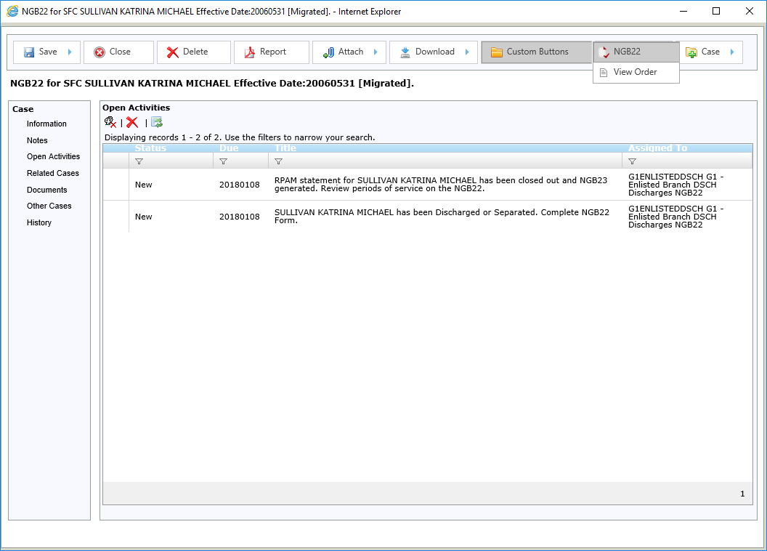
TwinEngines Discharges Processing NGB22 Cases
To work on the NGB22, use the NGB22 link.
The “View Order” link from the “Custom Buttons” menu will display the Discharge or Separation order that was published in MILPO Orders.

Slide 21
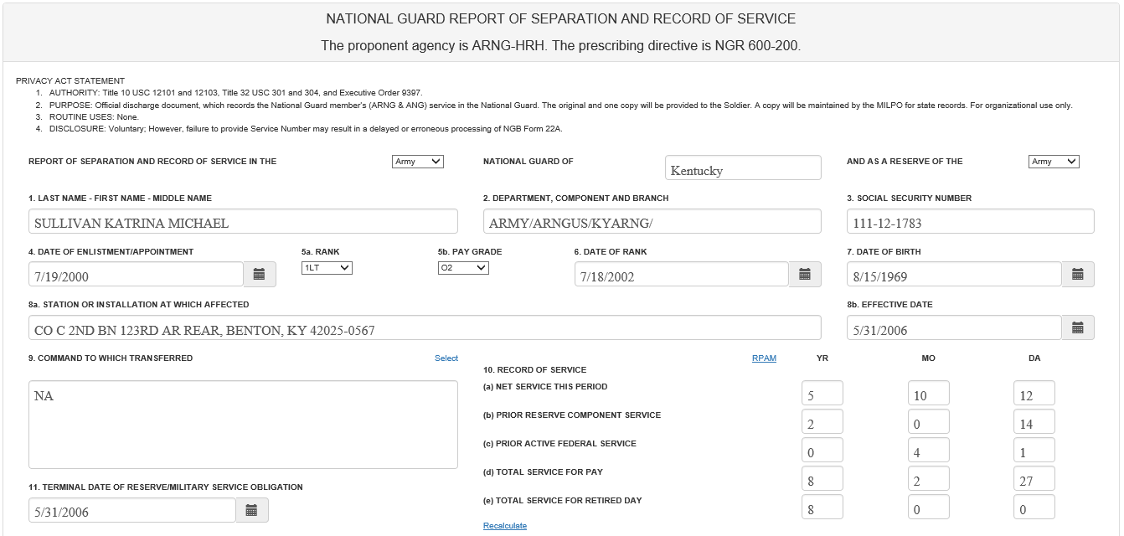
TwinEngines Discharges Processing NGB22 Cases
NOTE: This is a fictitious name & SSN
Command to Which Transferred can be selected from a pick-list.
Data that is pre-populated

Slide 22
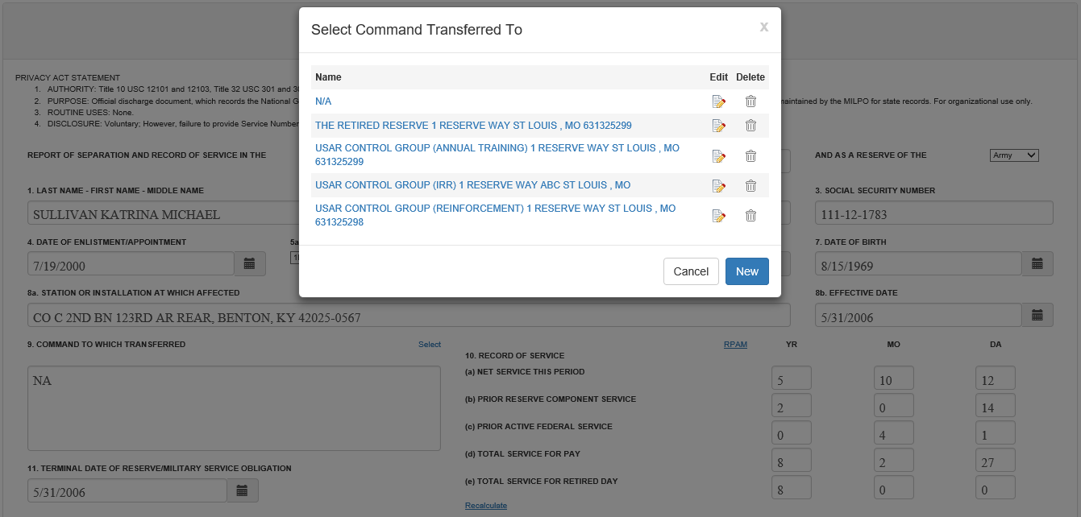
TwinEngines Discharges Processing NGB22 Cases

Slide 23
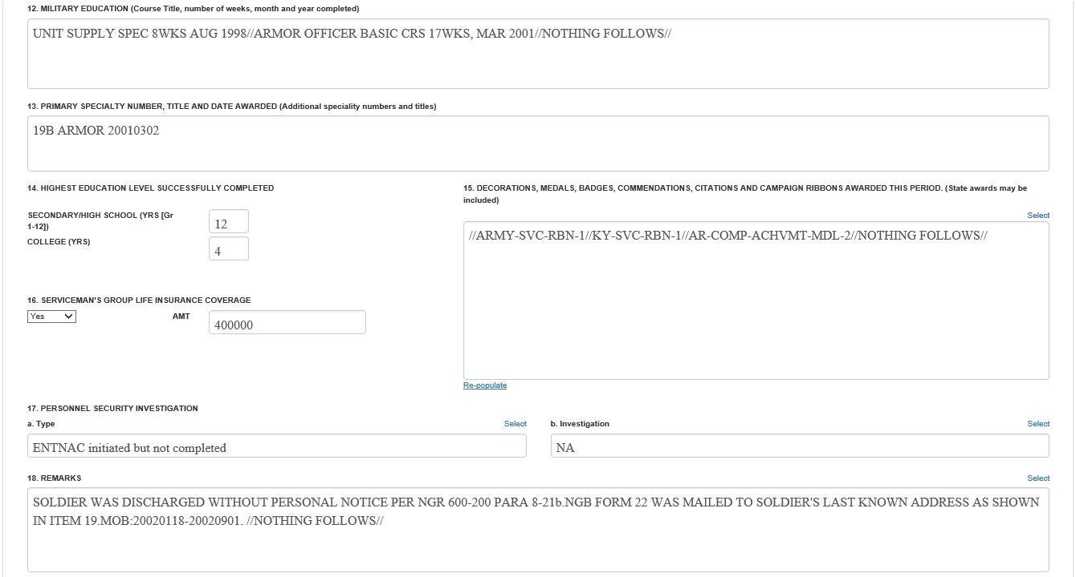
TwinEngines Discharges Processing NGB22 Cases
Data that is pre-populated
Quick way to add remarks

Slide 24
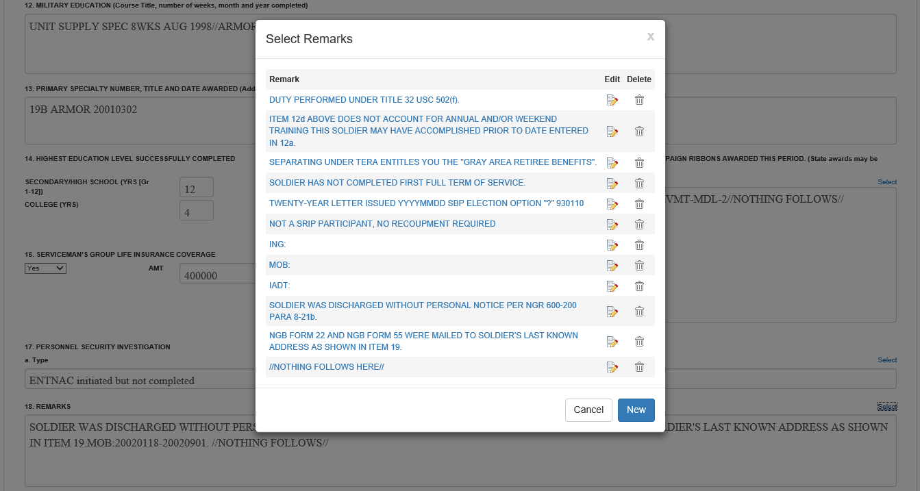
TwinEngines Discharges Processing NGB22 Cases
Edit comments here

Slide 25
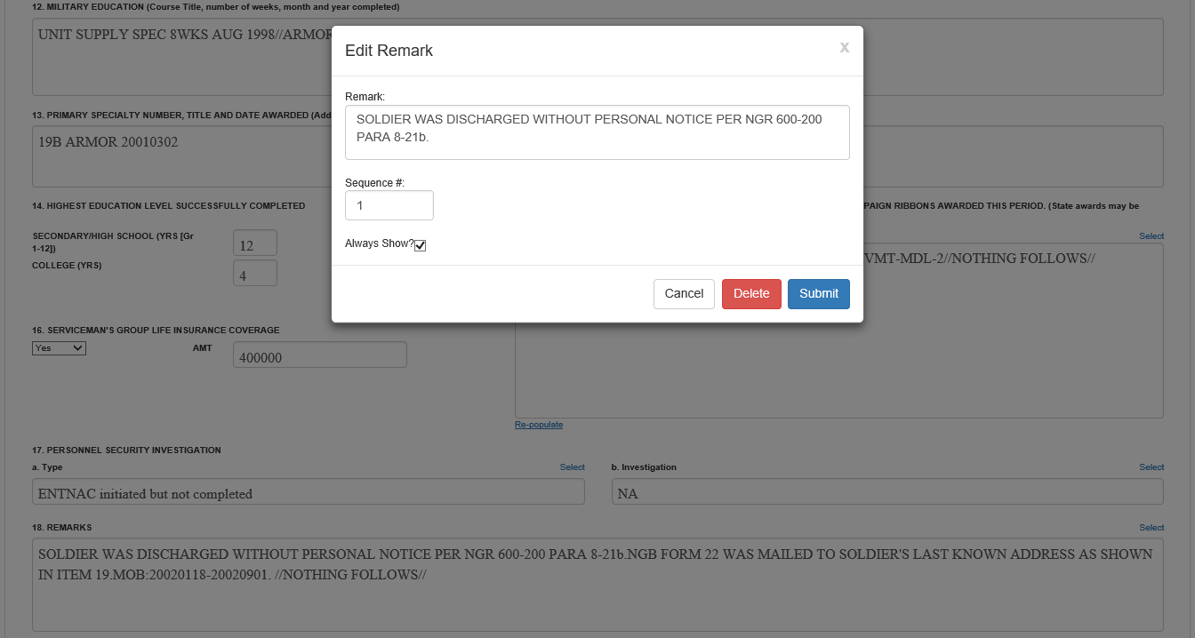
TwinEngines Discharges Processing NGB22 Cases
Checking this will put this remark on all NGB22s

Slide 26
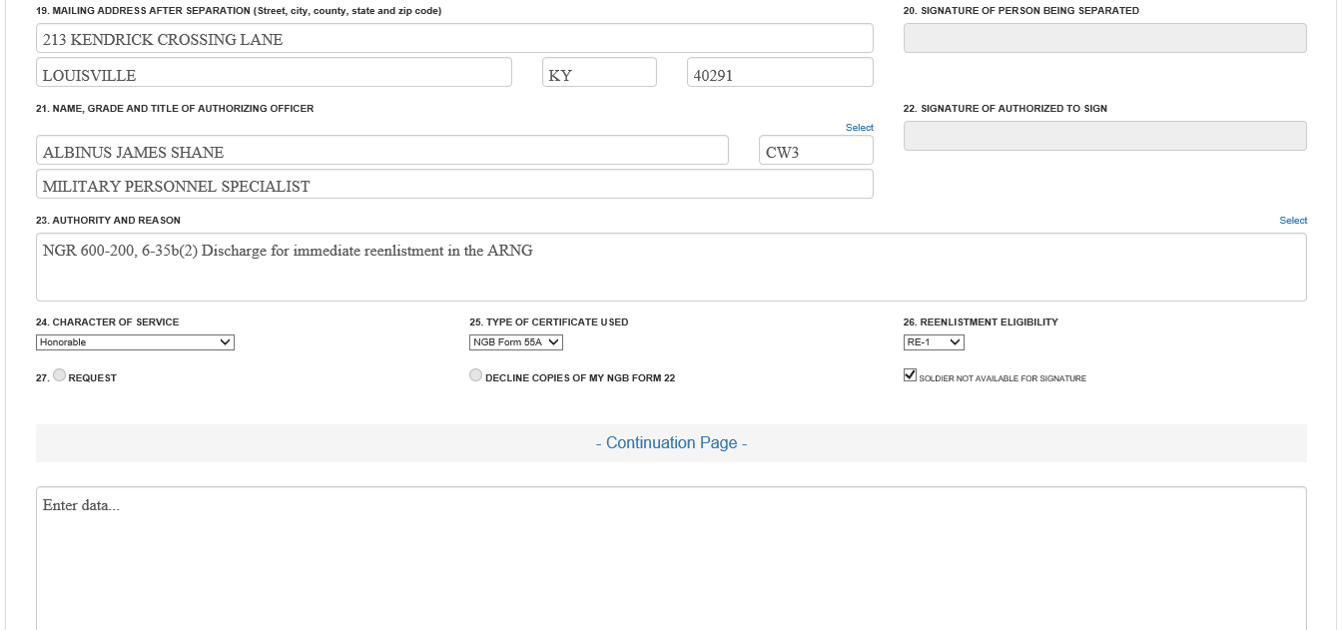
TwinEngines Discharges Processing NGB22 Cases
Pick list for authorizing officers
Pick list for Authority and Reason
Continuation page if needed.
Data that is pre-populated

Slide 27
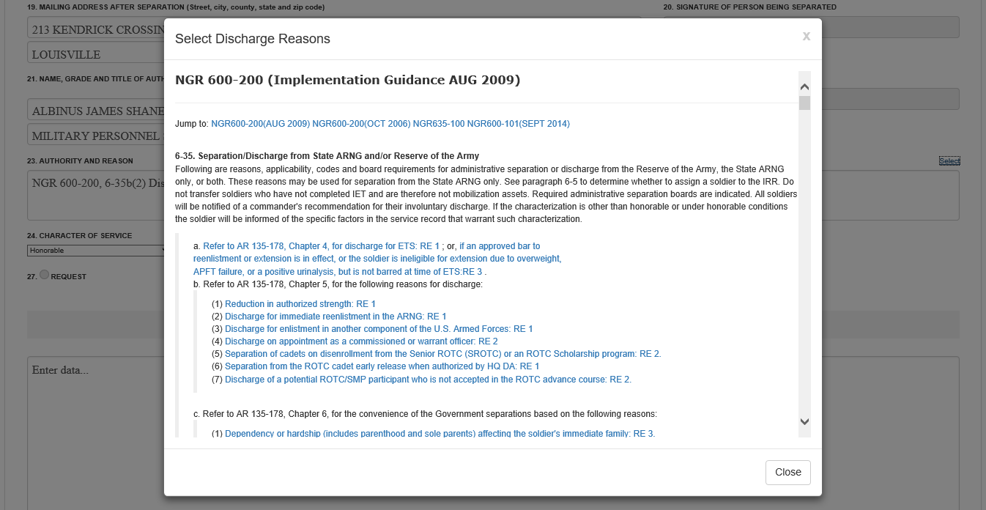
TwinEngines Discharges Processing NGB22 Cases
Automatically populates RE Code when selected.
Multiple regulations to select from.

Slide 28
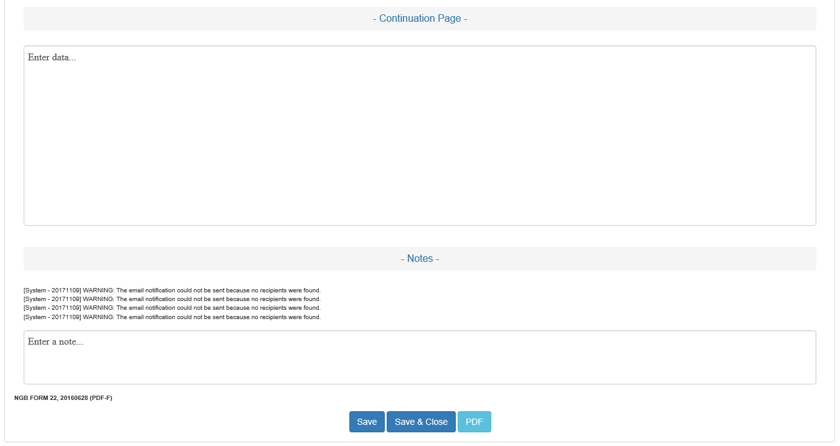
TwinEngines Discharges Processing NGB22 Cases
Generate the PDF

Slide 29
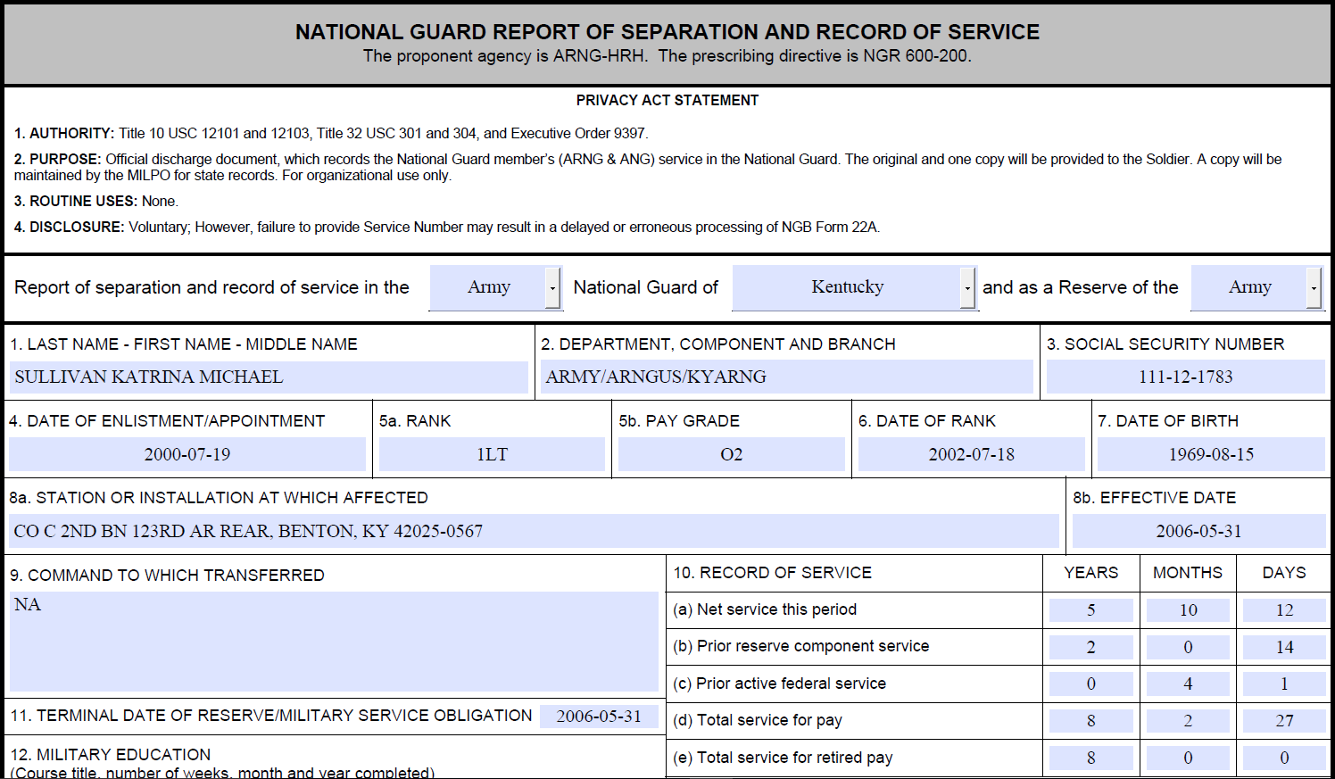
TwinEngines Discharges Processing NGB22 Cases

Slide 30
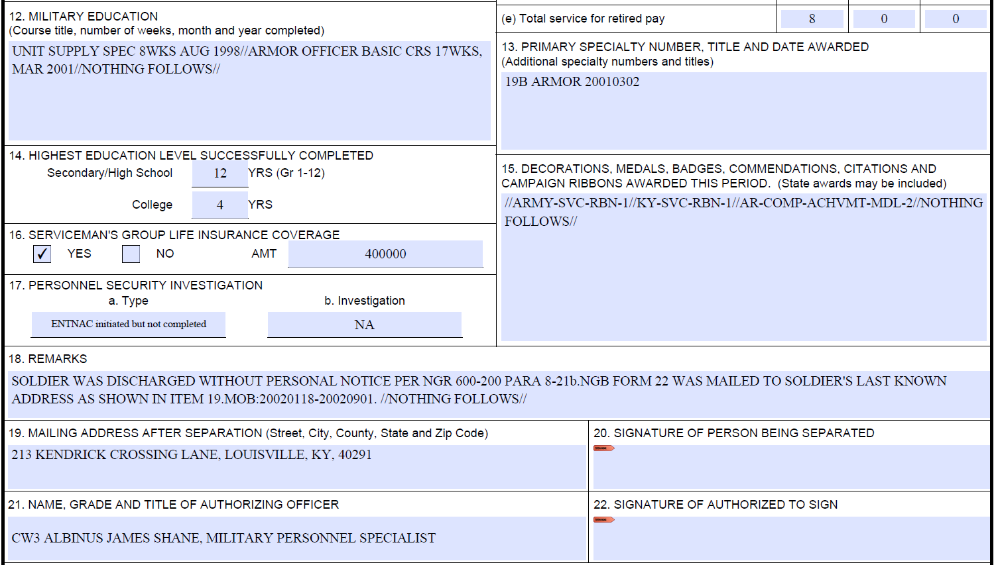
TwinEngines Discharges Processing NGB22 Cases

Slide 31
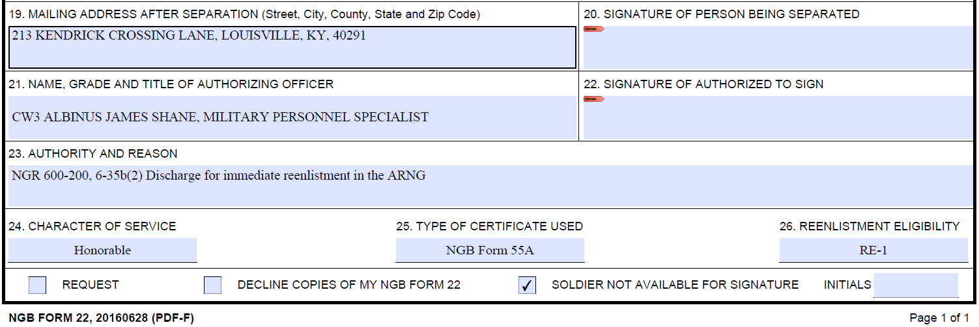
TwinEngines Discharges Processing NGB22 Cases
Form is saved locally, then attached back to the case to continue the process.
Digital Signatures now available
Soldier not available for Signature

Slide 32
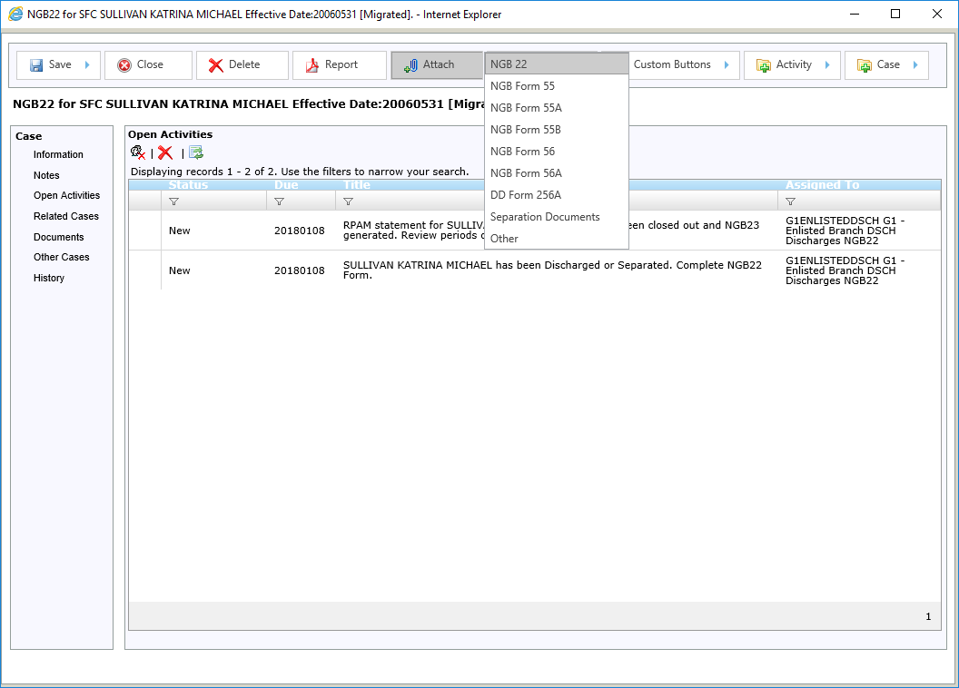
TwinEngines Discharges Processing NGB22 Cases
Use the Attach button to upload the NGB22 PDF back to the case.

Slide 33
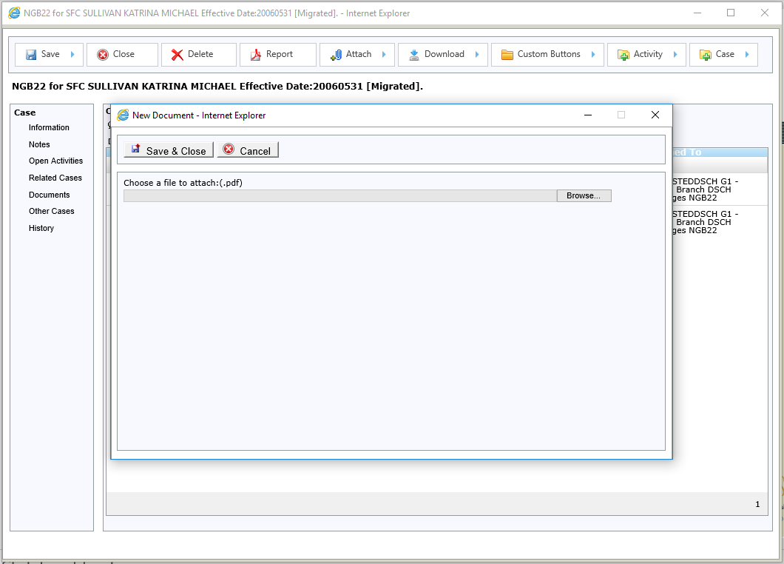
TwinEngines Discharges Processing NGB22 Cases

Slide 34
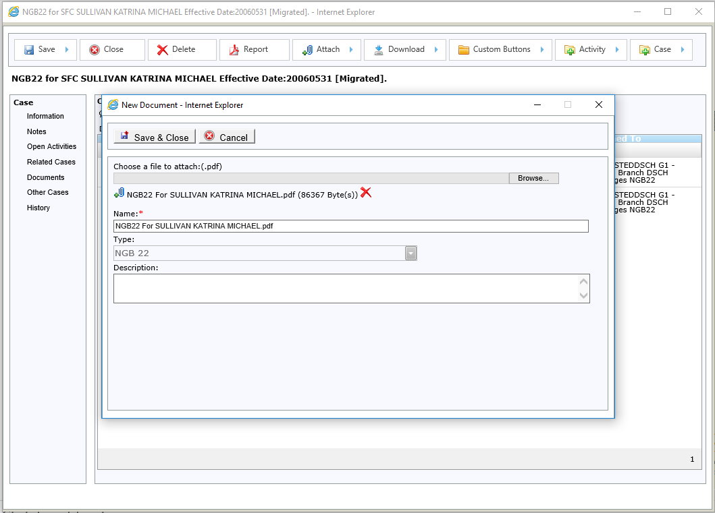
TwinEngines Discharges Processing NGB22 Cases

Slide 35
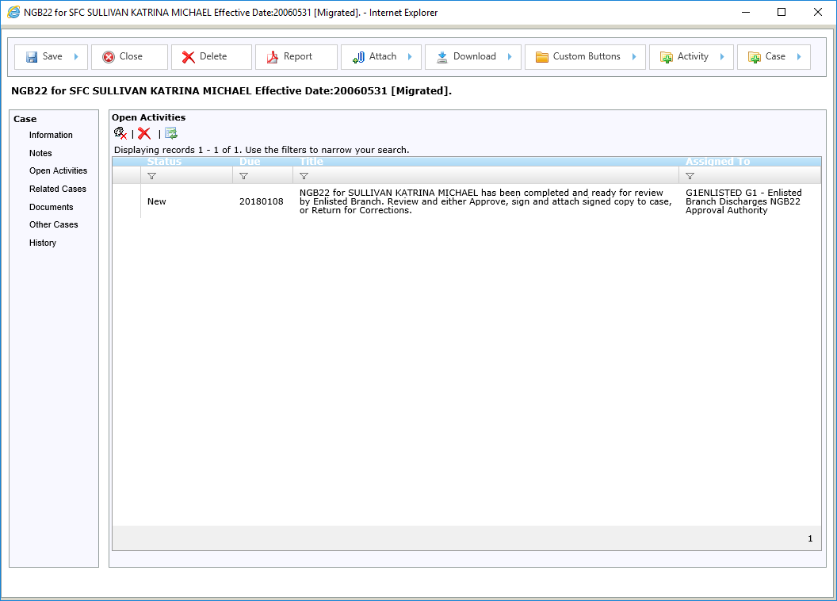
TwinEngines Discharges Processing NGB22 Cases
Task to complete the NGB22 is automatically closed once the 22 PDF is attached to the case.
Now the Discharges NGB22 Approval Authority at either the Enlisted or Officers branch is assigned the task to review and approve the 22.
An email notification will go to all users that are assigned the “Discharges NGB22 Approval Authority” role at the Enlisted or Discharges branch.

Slide 36
TwinEngines Discharges Processing NGB22 Cases
The email contains links to the task to approve the 22, but you can also see it here.

Slide 37
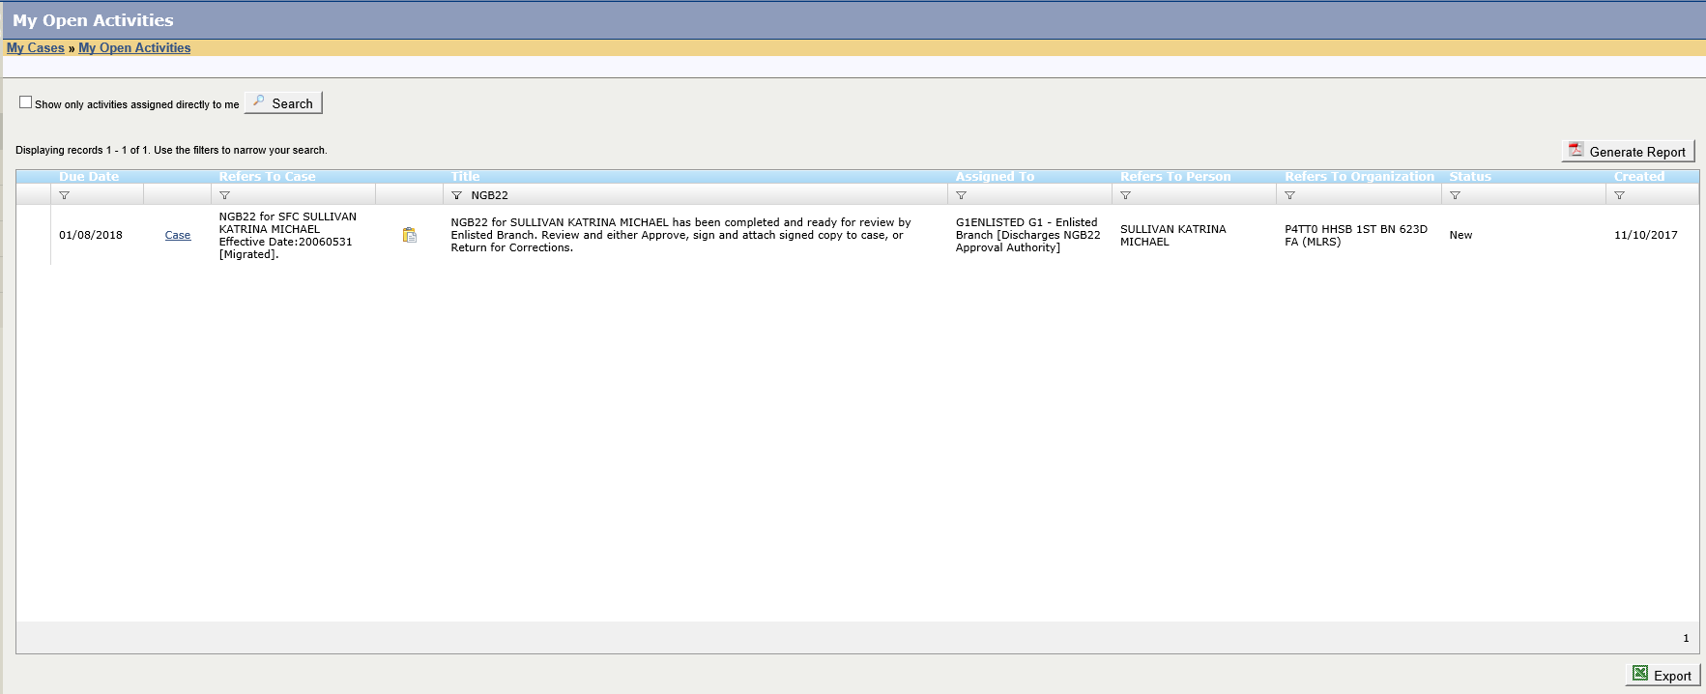
TwinEngines Discharges Processing NGB22 Cases
You can open the full case from here.
Click here or double click the record to open just this activity.

Slide 38
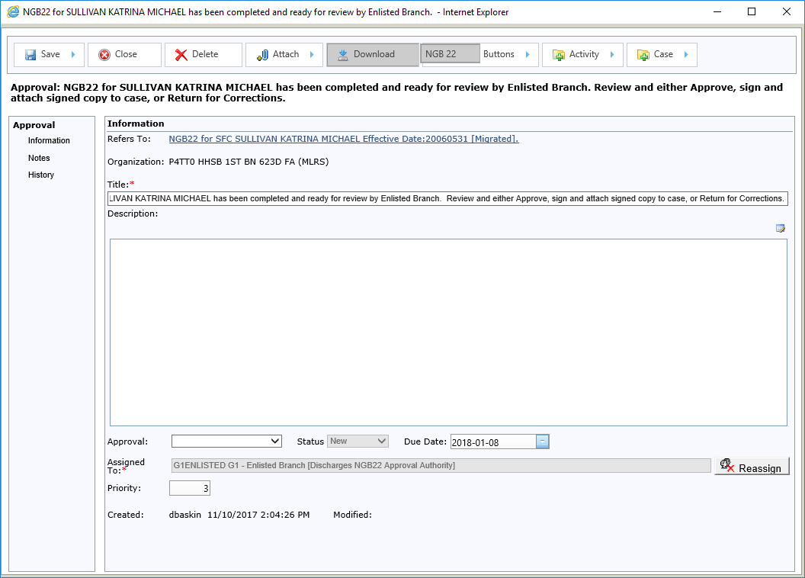
TwinEngines Discharges Processing NGB22 Cases
Use the Download button to open the PDF for review.

Slide 39
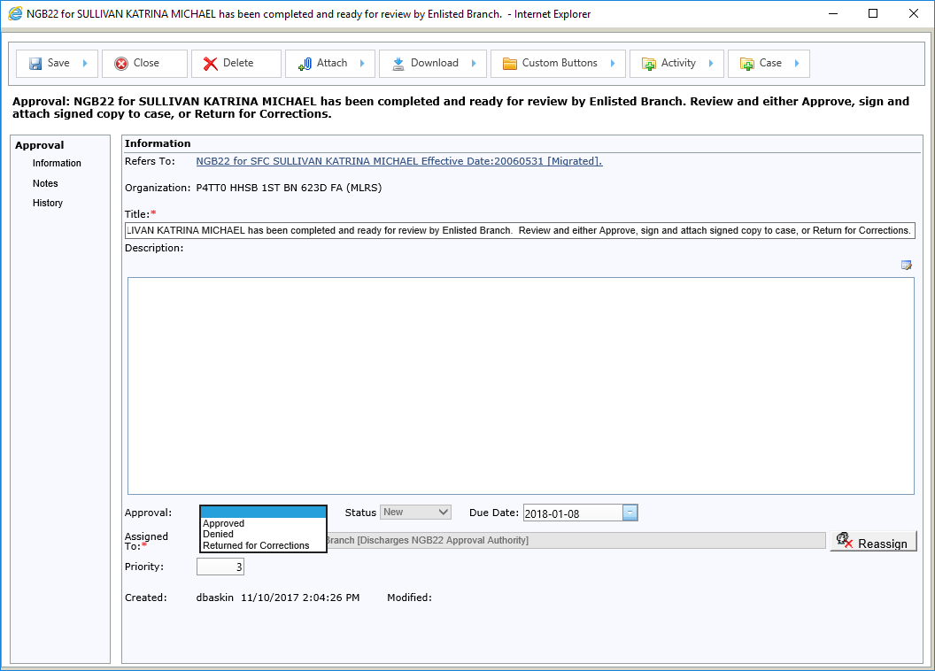
TwinEngines Discharges Processing NGB22 Cases
Mark it as Approved, Denied, or Returned for Corrections.
If Denied or Returned for Corrections it is sent back to the Discharges NGB22 user

Slide 40
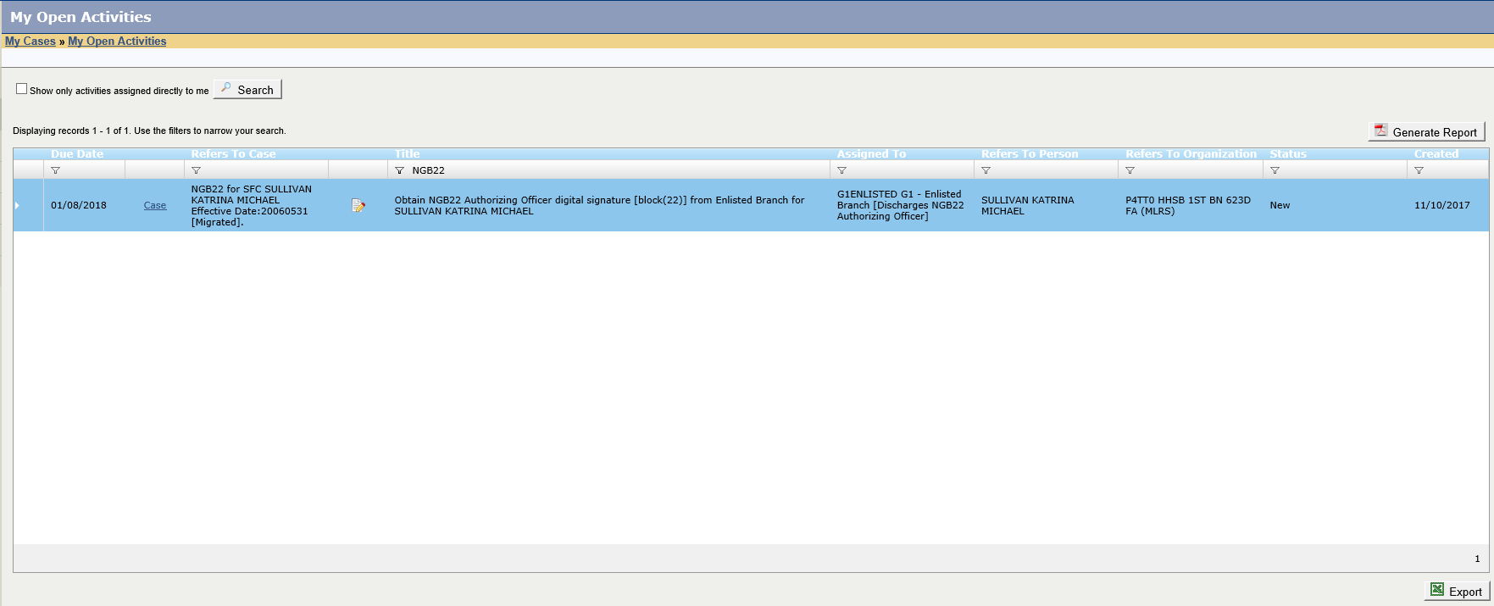
TwinEngines Discharges Processing NGB22 Cases
After the 22 is approved, a task is created to get the Authorizing Officer’s digital signature.

Slide 41
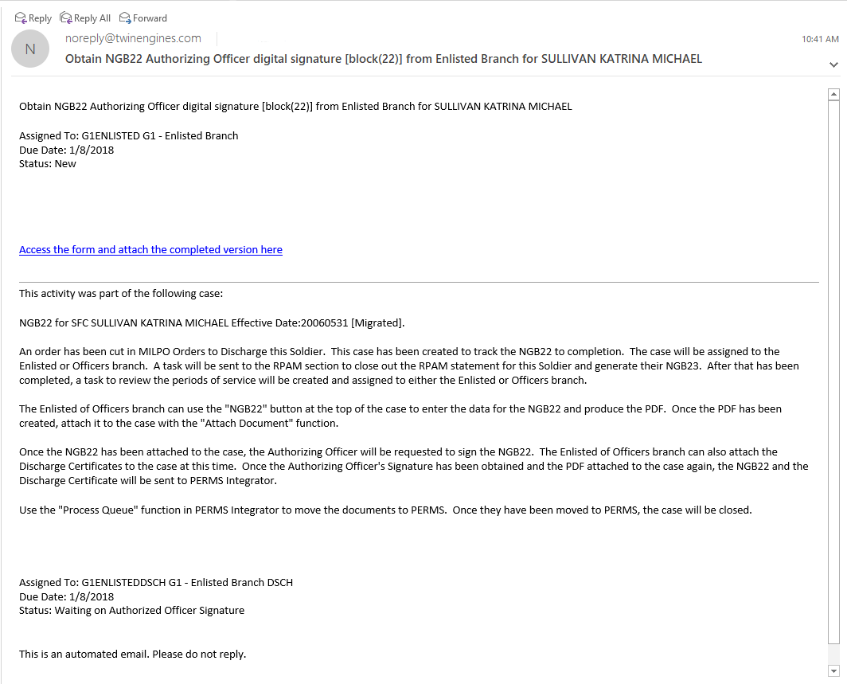
TwinEngines Discharges Processing NGB22 Cases
This is an example of the email notifications sent by the system.
The link will take you to where you can download the latest version of the form and attach the revised/signed version back to the case.
The system also allows you to attach the NGB22 directly to the email as an attachment.

Slide 42
TwinEngines Discharges Processing NGB22 Cases
This is the page the link in the email takes you to.
Download the NGB22 PDF from the link above.

Slide 43
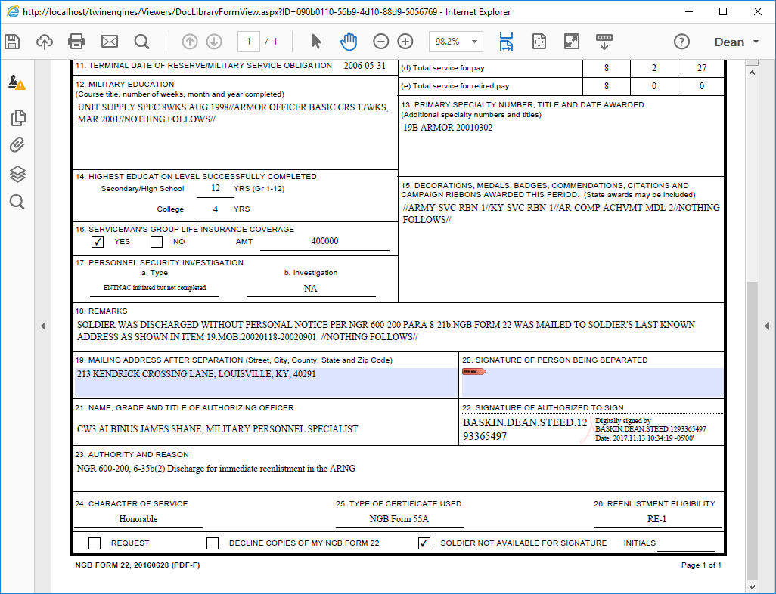
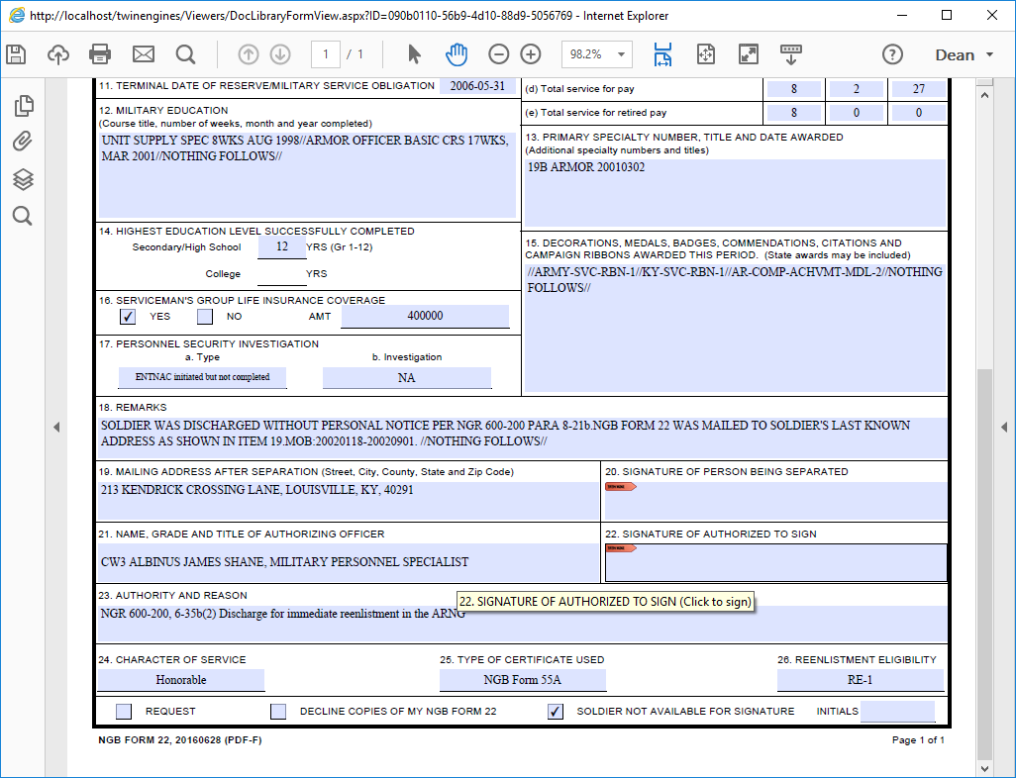
TwinEngines Discharges Processing NGB22 Cases
Digitally sign the NGB22, then attach it back to the case.

Slide 44
TwinEngines Discharges Processing NGB22 Cases
Use the link here to attach the digitally signed NGB22 back to the case.

Slide 45
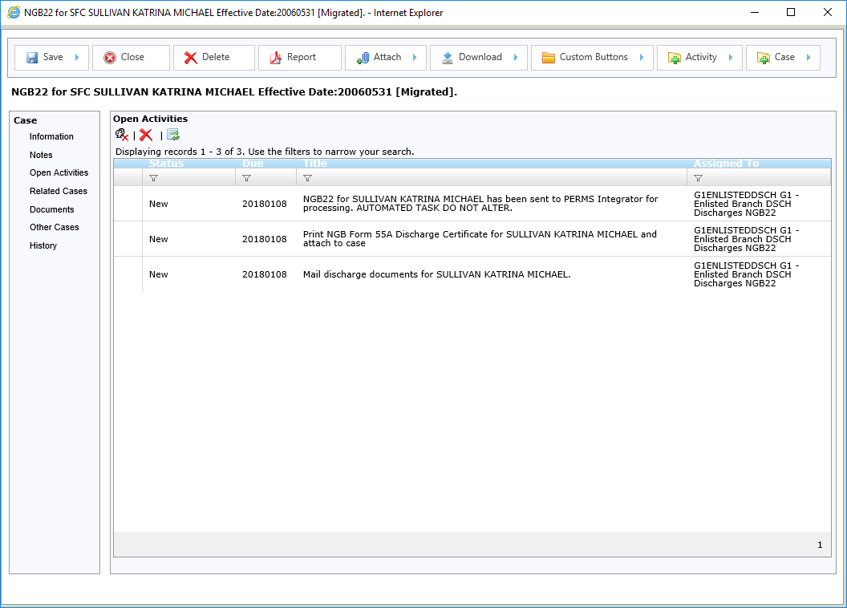
TwinEngines Discharges Processing NGB22 Cases
Once the NGB22 is digitally signed, the system automatically sends the 22 to PERMS via PERMS Integrator.
No need to print, scan and index – the system handles that for you.
You can also attach a scanned copy of the Discharge Certificate.

Slide 46
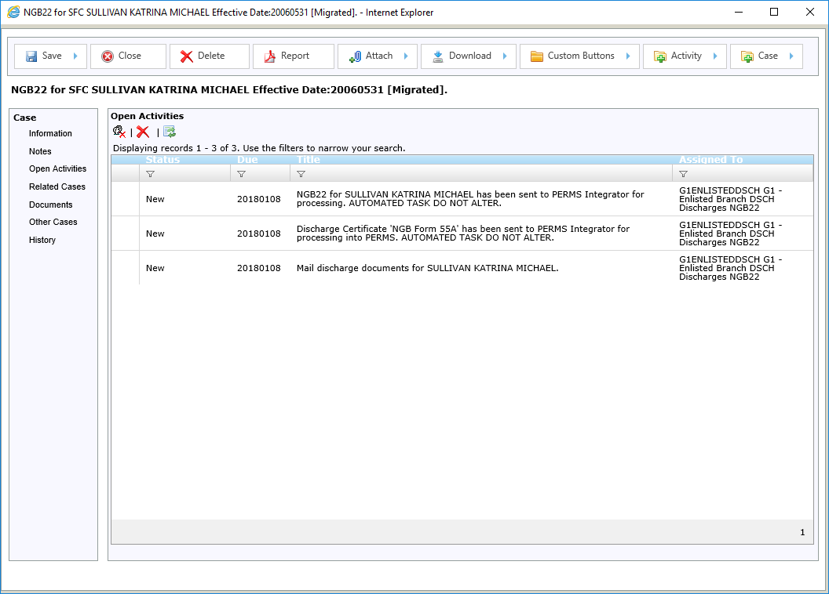
TwinEngines Discharges Processing NGB22 Cases

Slide 47
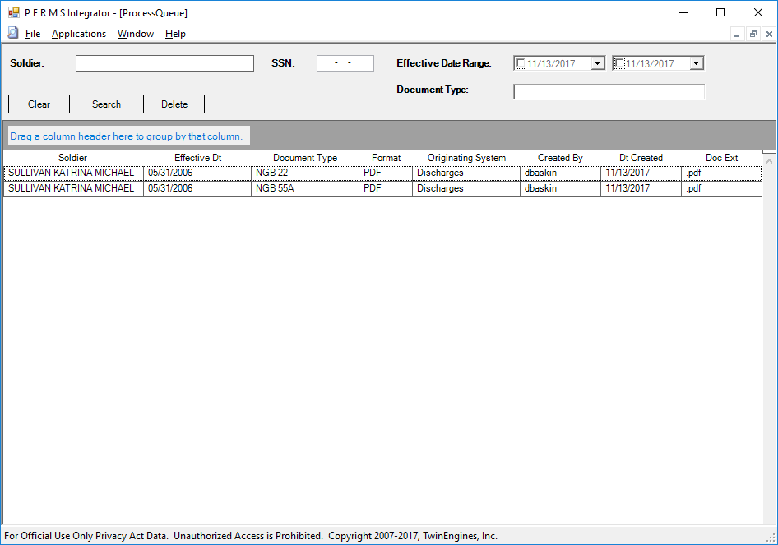
TwinEngines Discharges Processing NGB22 Cases
In PERMS Integrator, go to:
Applications
-> Process Queue
You will see the NGB22 and the certificate. Select the records and do:
File -> Export
PERMS Integrator will convert the documents to TIFF, index them, and send them to PERMS for you.

Slide 48
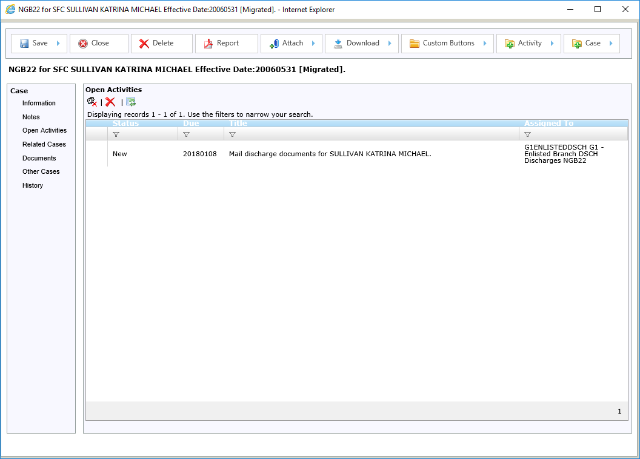
TwinEngines Discharges Processing NGB22 Cases
Once PERMS Integrator has processed the NGB22 and Certificate, the tasks are automatically closed.
The last step is to mail the discharge documents to the Soldier

Slide 49
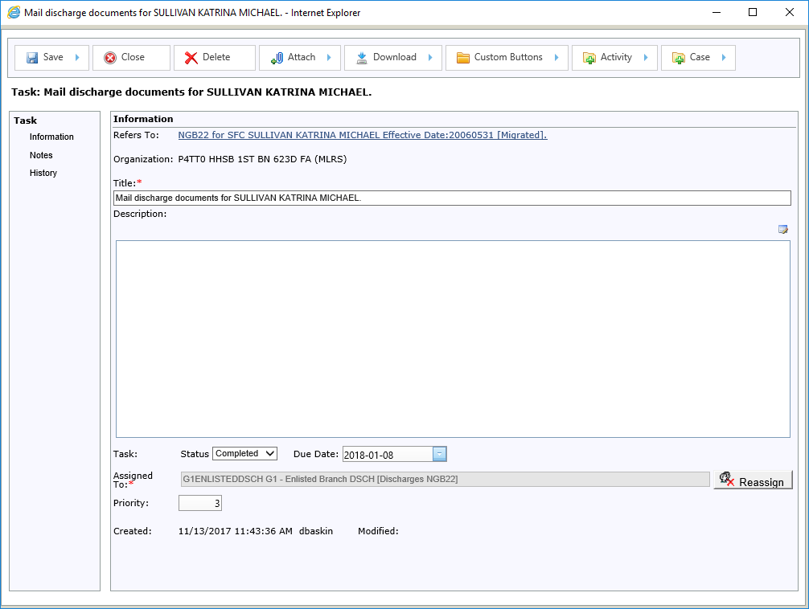
TwinEngines Discharges Processing NGB22 Cases
When the documents are mailed, mark this task as completed.

Slide 50
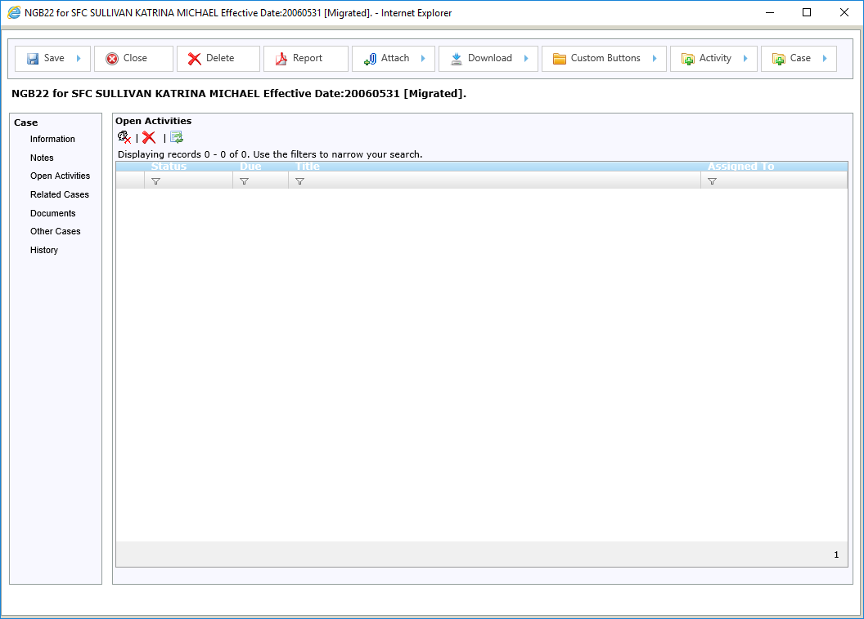
TwinEngines Discharges Processing NGB22 Cases

Slide 51
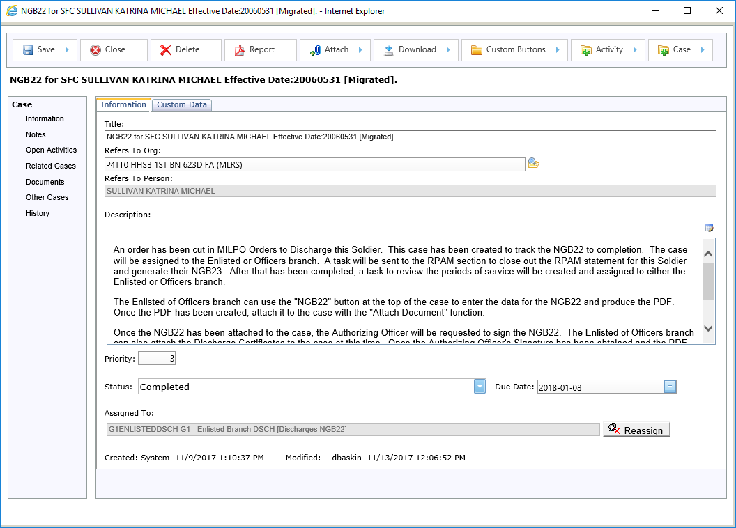
TwinEngines Discharges Processing NGB22 Cases
Once all activities have been completed, the case is automatically marked as completed.

Slide 52
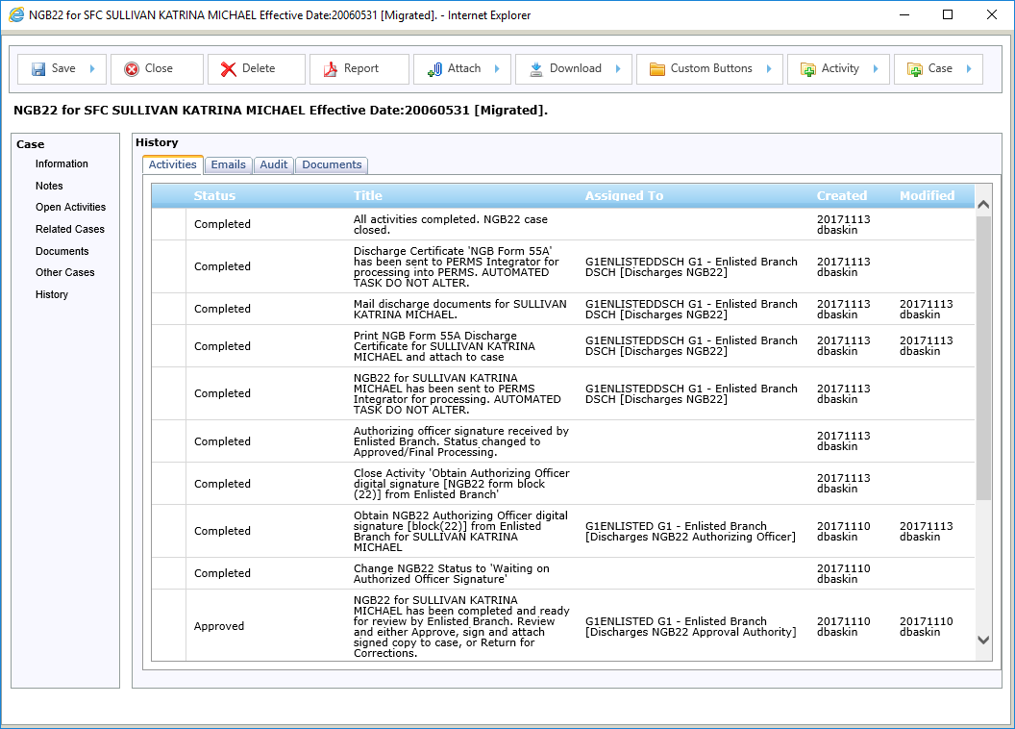
TwinEngines Discharges Processing NGB22 Cases
Activities shows all actions that occurred to the case.
The history tab of the case gives you a complete audit log of everything that happened to the case.

Slide 53
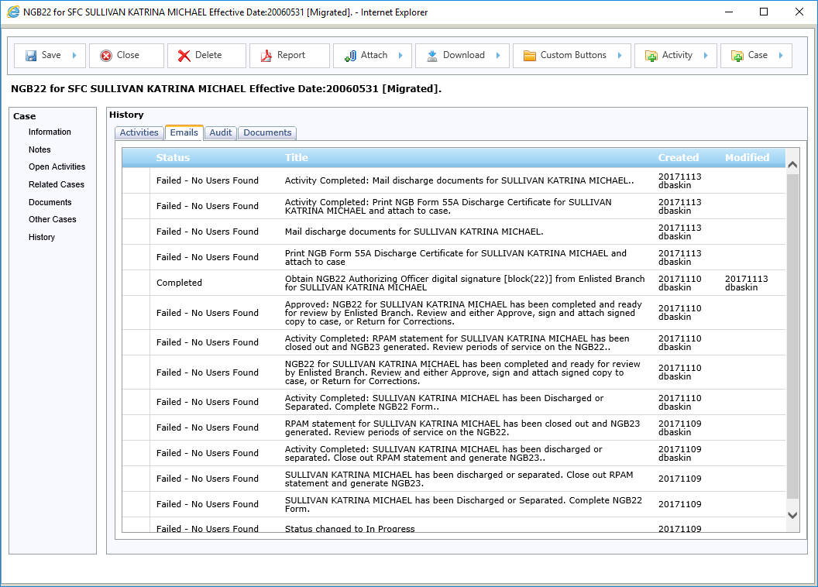
TwinEngines Discharges Processing NGB22 Cases
Emails shows all email notifications that went out and who they went to.

Slide 54
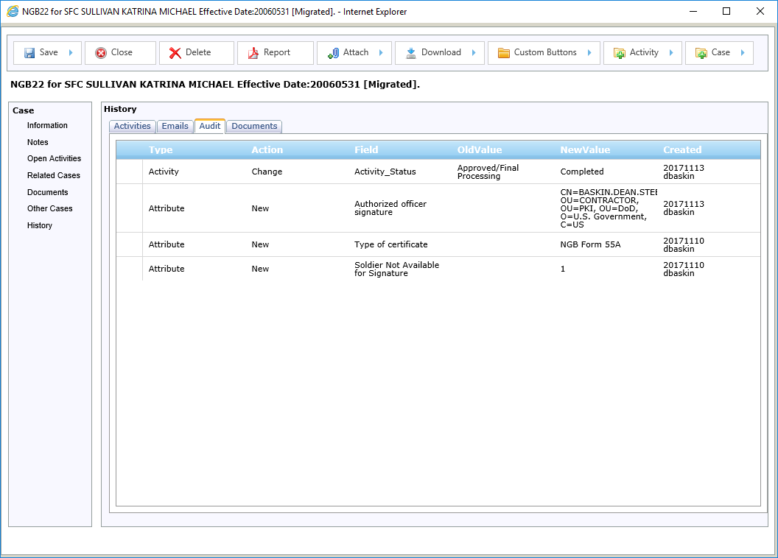
TwinEngines Discharges Processing NGB22 Cases
Audit shows changes to the case data elements and documents that are tracked within the case (e.g. the digital signatures).

Slide 55
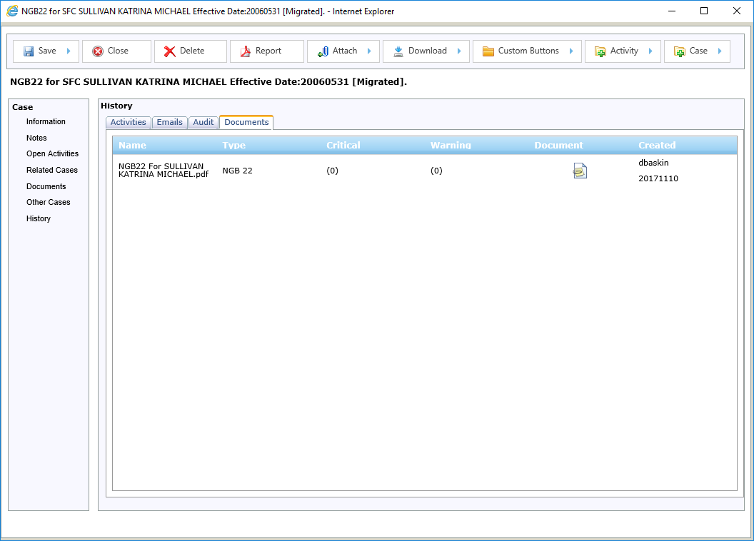
TwinEngines Discharges Processing NGB22 Cases
Documents shows all the previous versions of documents that are attached to the case.
For example, this document is the first version of the NGB22 that did not include the digital signature.

Slide 56
TwinEngines Discharges Reporting
This option shows you how many cases or activities are open by organization.

Slide 57
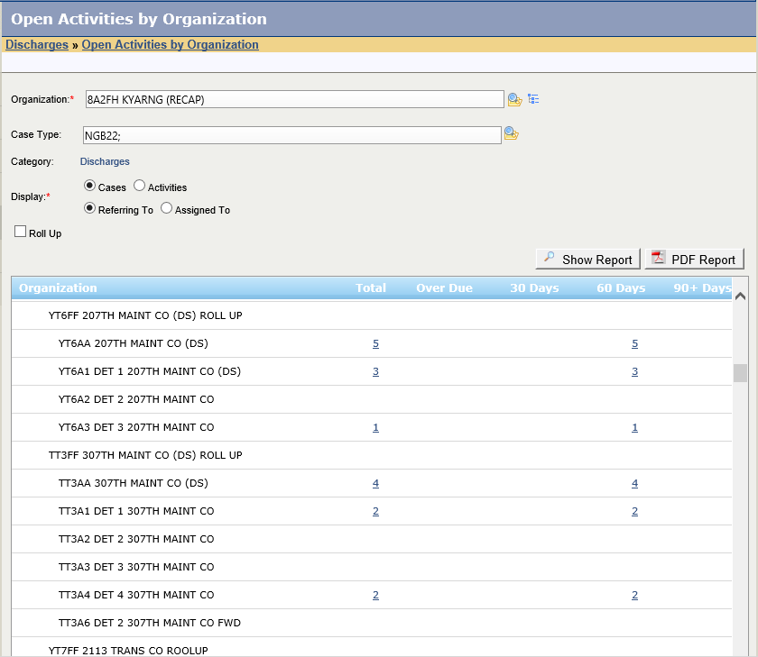
TwinEngines Discharges Reporting
Several options to choose from.
Drill down to see individual cases.

Slide 58
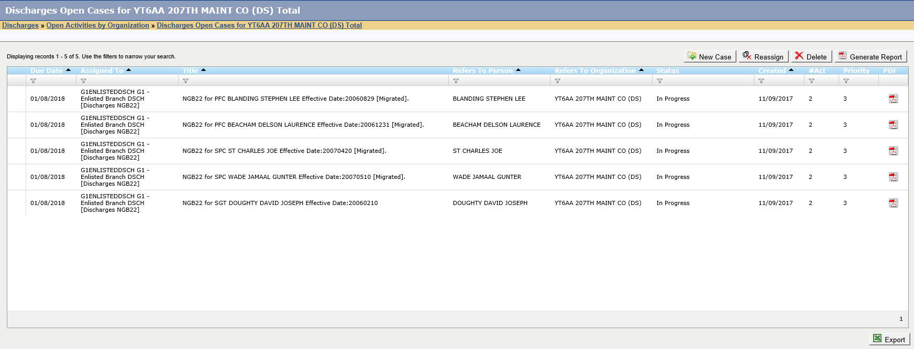
TwinEngines Discharges Reporting

Slide 59
TwinEngines Discharges Reporting
This option shows you the number of cases that have been created and completed over a time range.

Slide 60
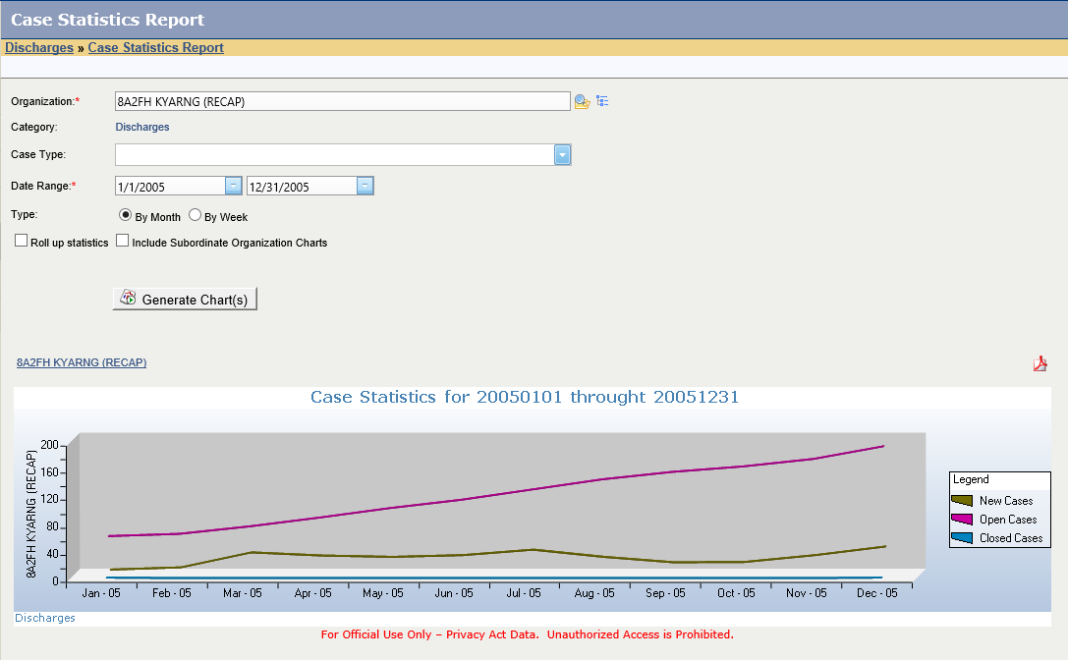
TwinEngines Discharges Reporting

Slide 61
TwinEngines Discharges Migration
For questions, live demos, or to request a license key, contact:
Dean Baskin
TwinEngines, Inc.
859-536-2540
dbaskin@twinengines.com

